Slide 1
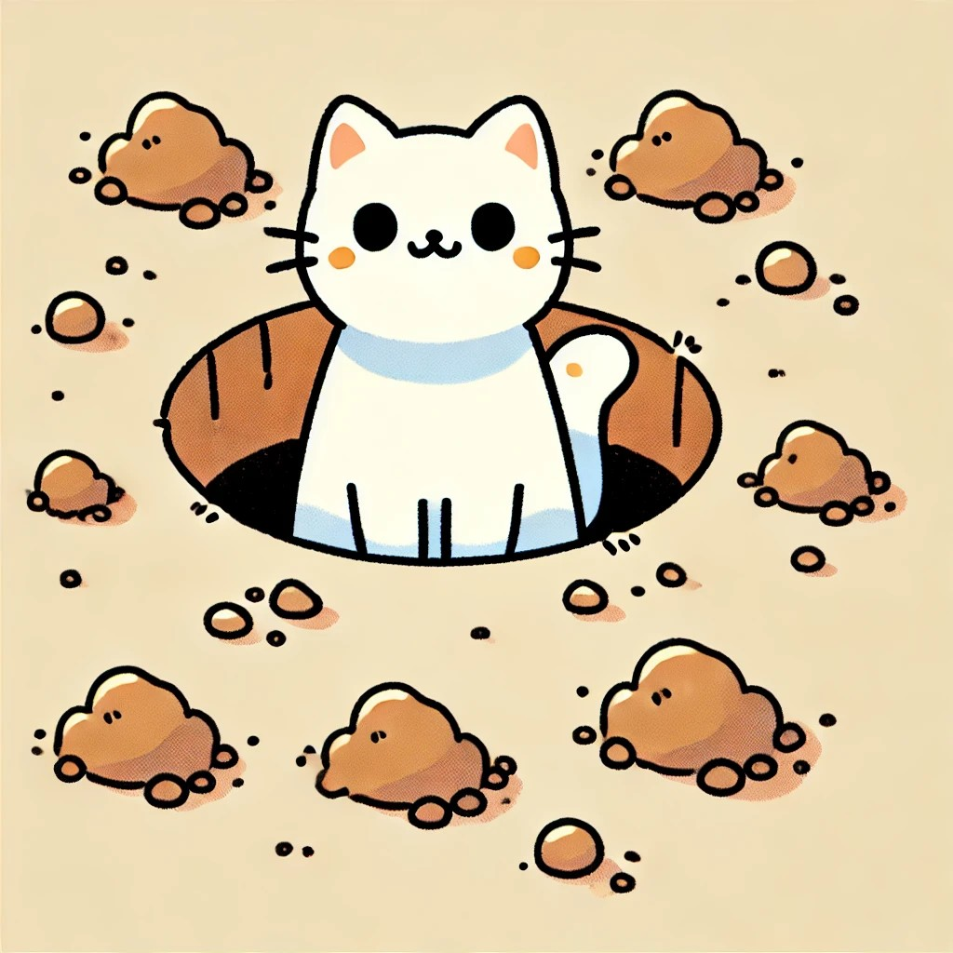
Set 1
The Cat is in the Pit.

Slide 2
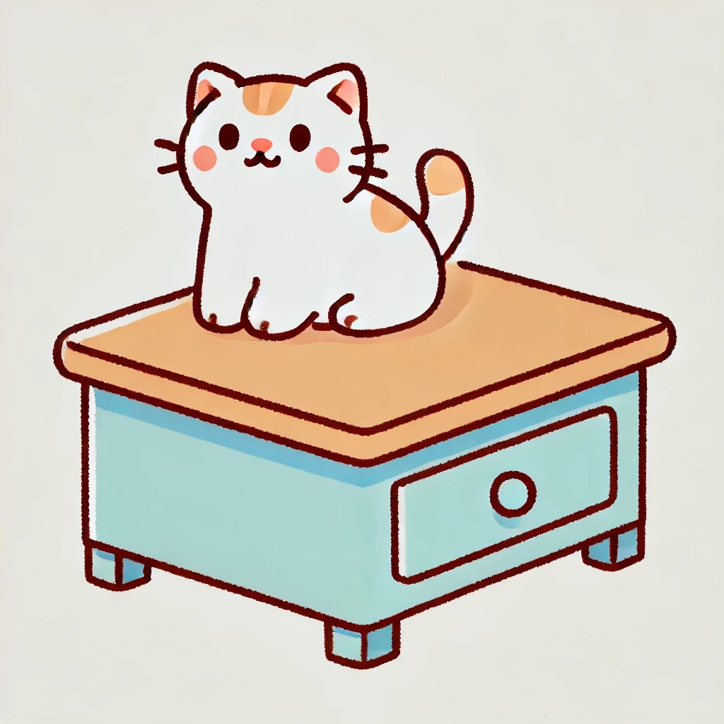
The Cat is on.

Slide 3

The Cat is in.

Slide 4
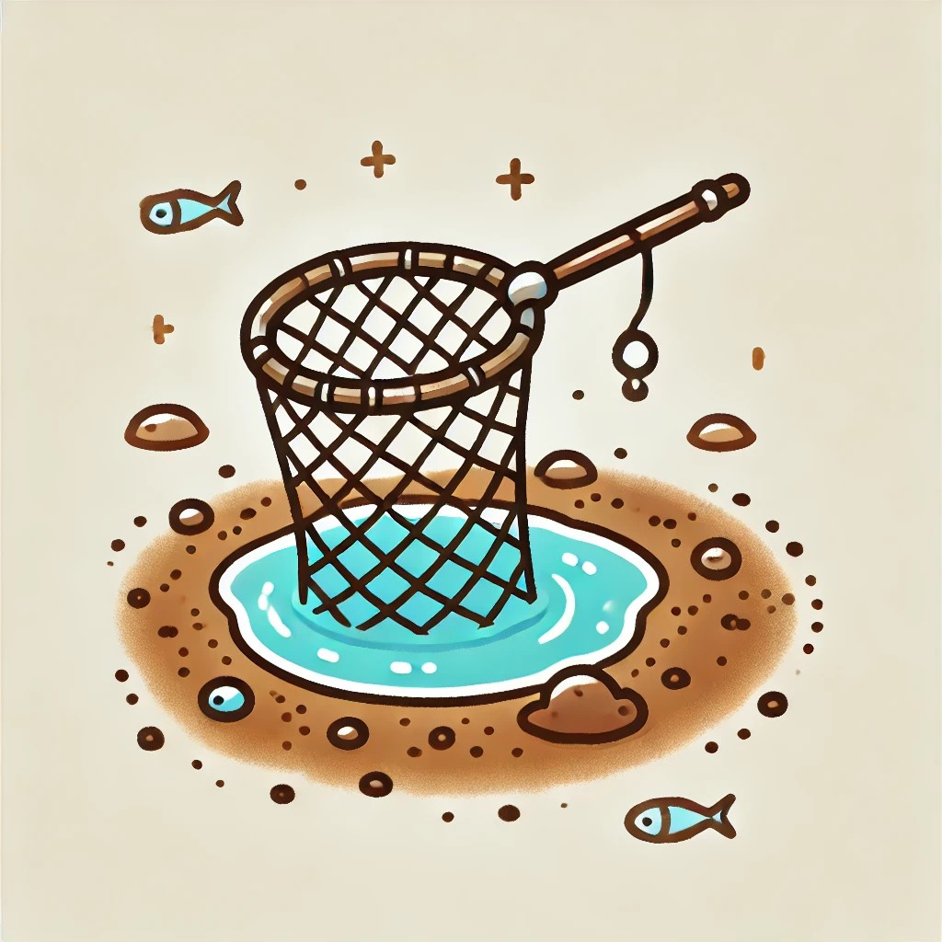
The Net is in the Pit.

Slide 5
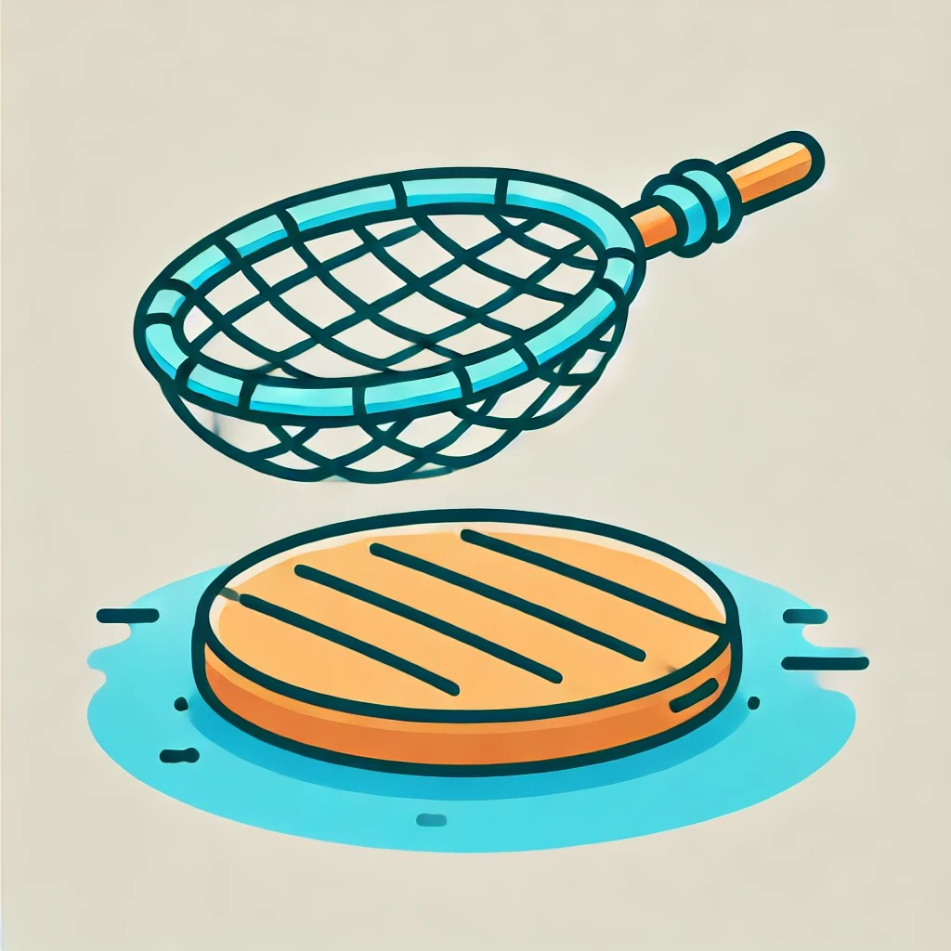
The Net is on.

Slide 6
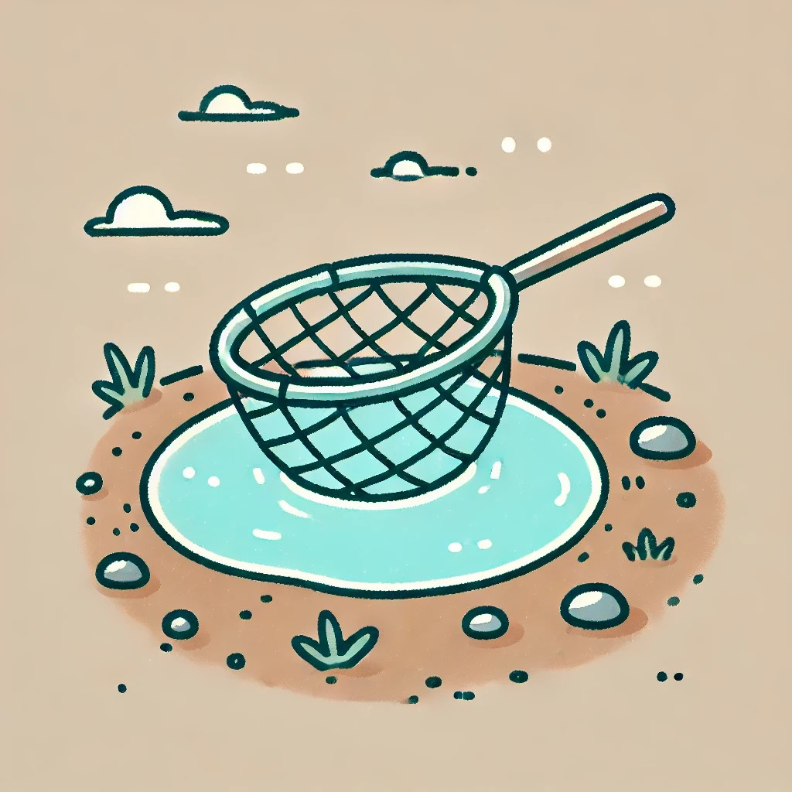
The Net is in.

Slide 7
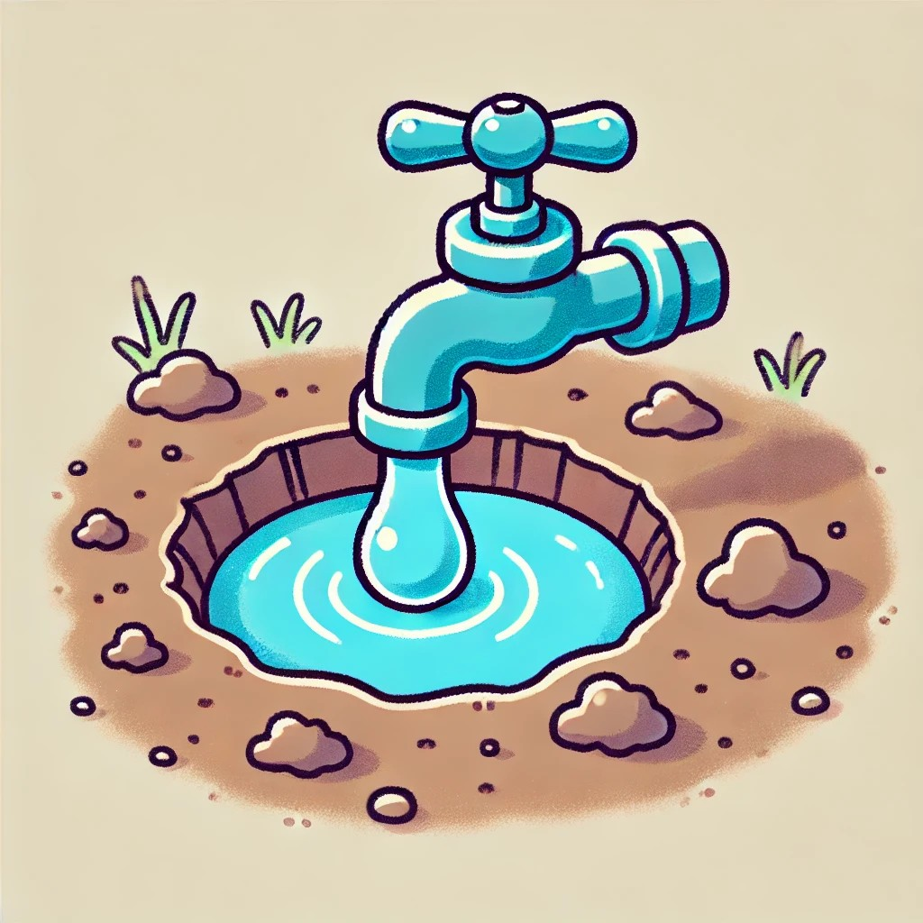
The Tap is in the Pit.

Slide 8
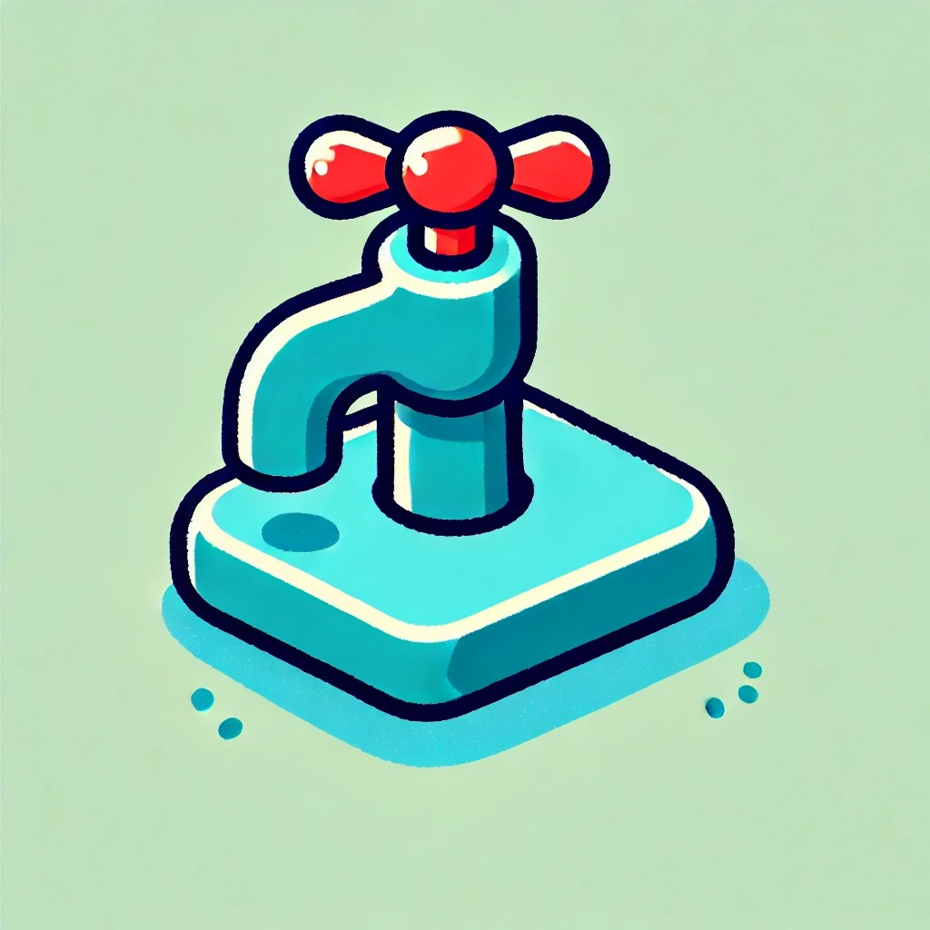
The Tap is on.

Slide 9
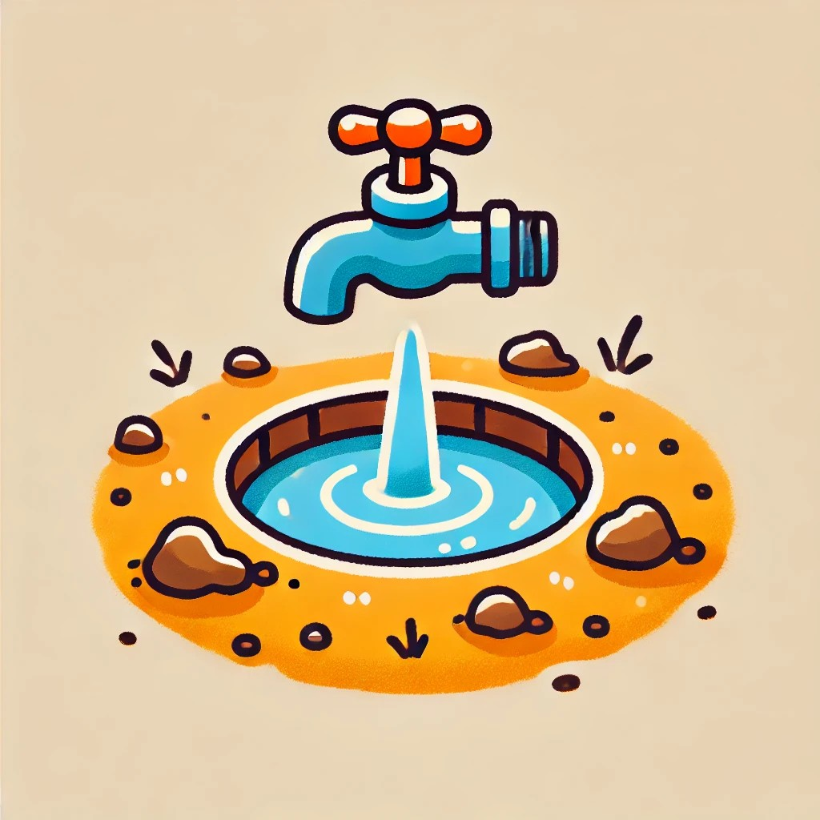
The Tap is in.

Slide 10
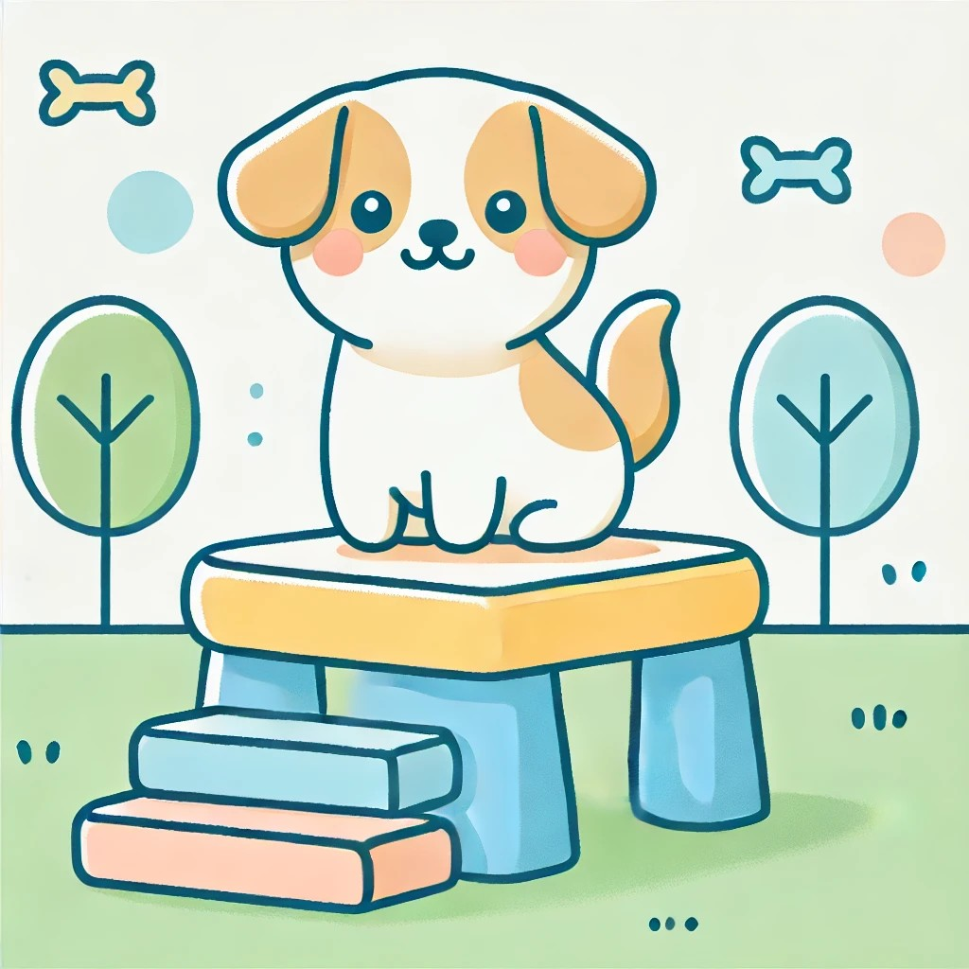
The Pet is on.

Slide 11
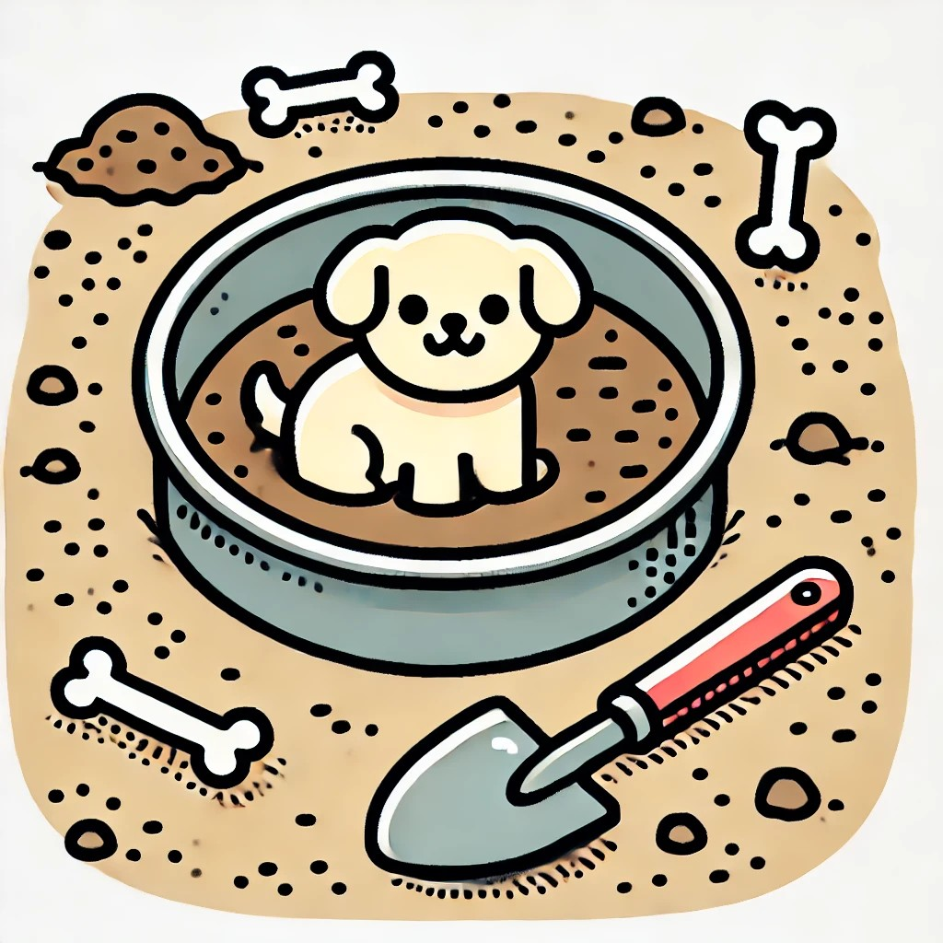
The Pet is in.

Slide 12
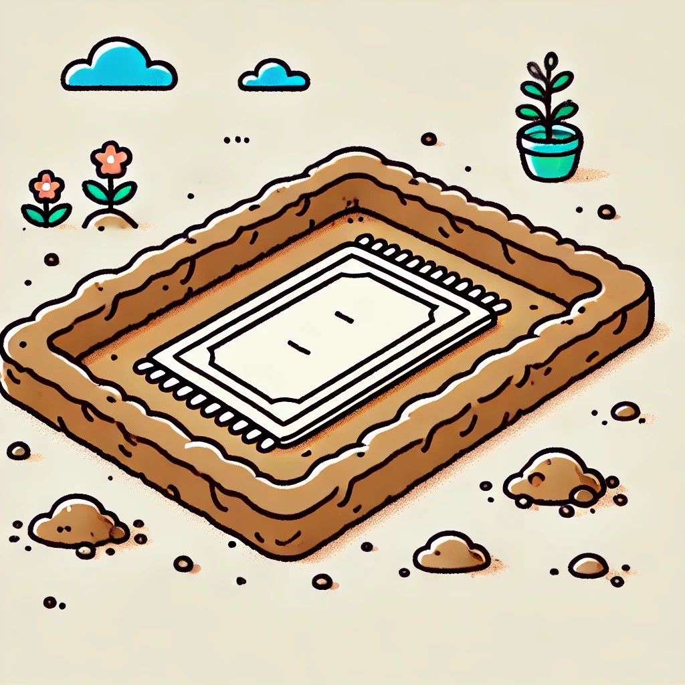
The Mat is in the Pit.

Slide 13
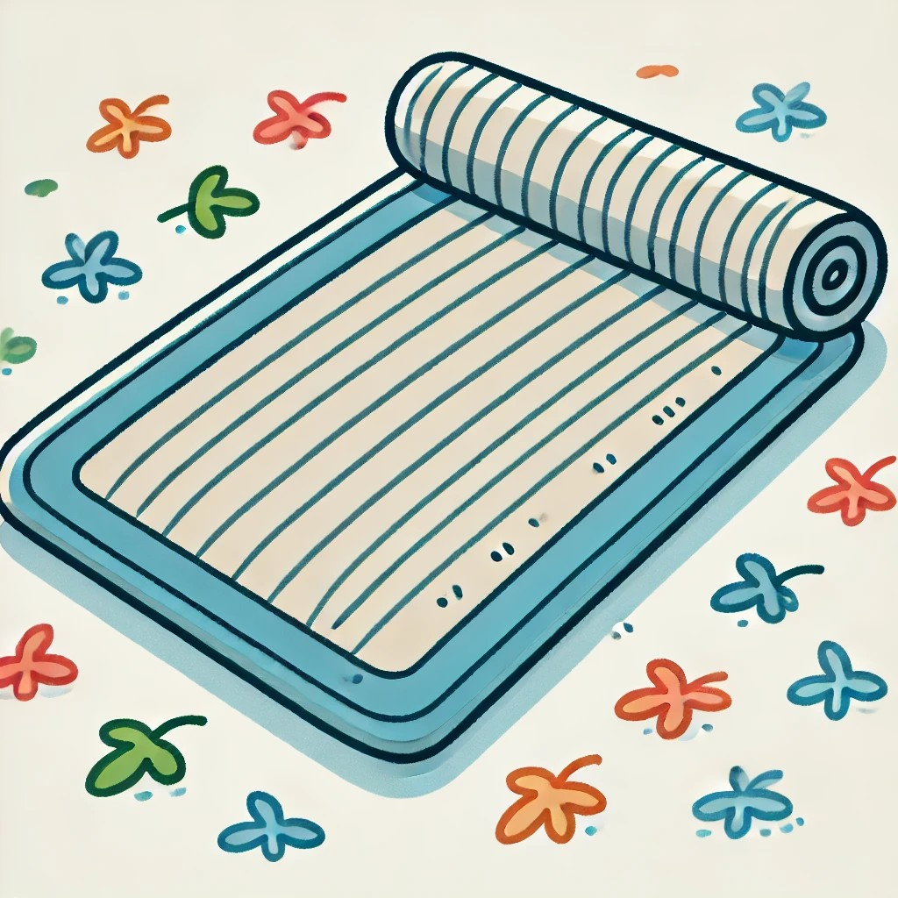
The Mat is on.

Slide 14
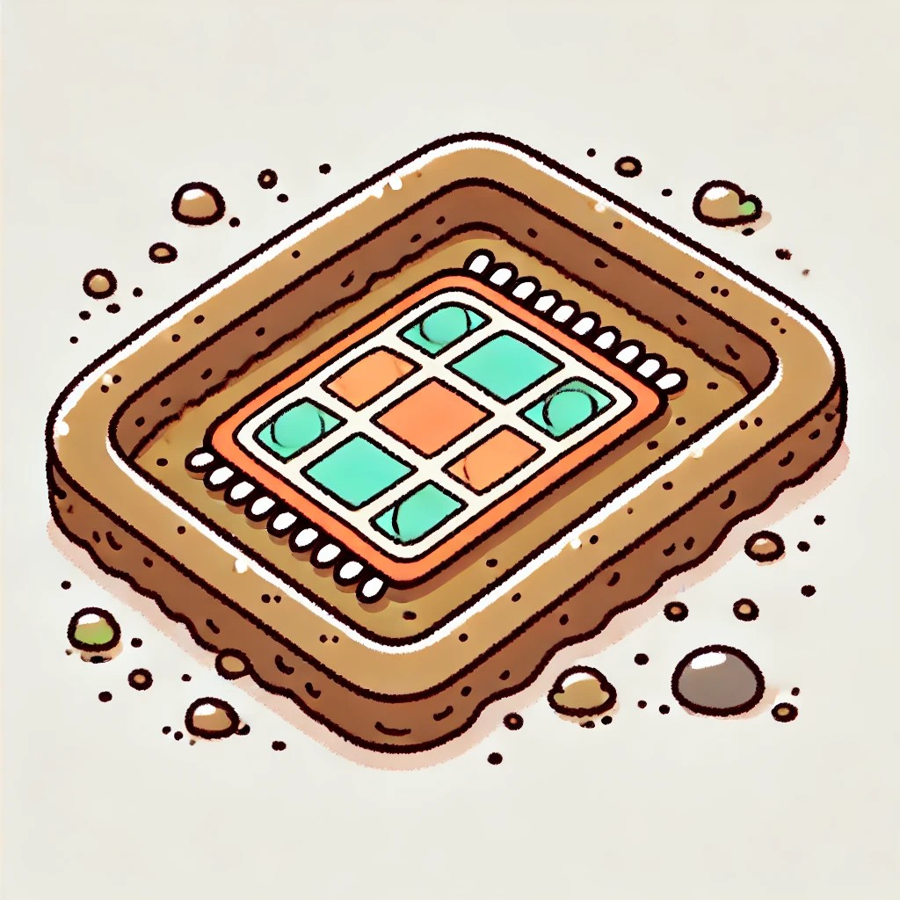
The Mat is in.

Slide 15
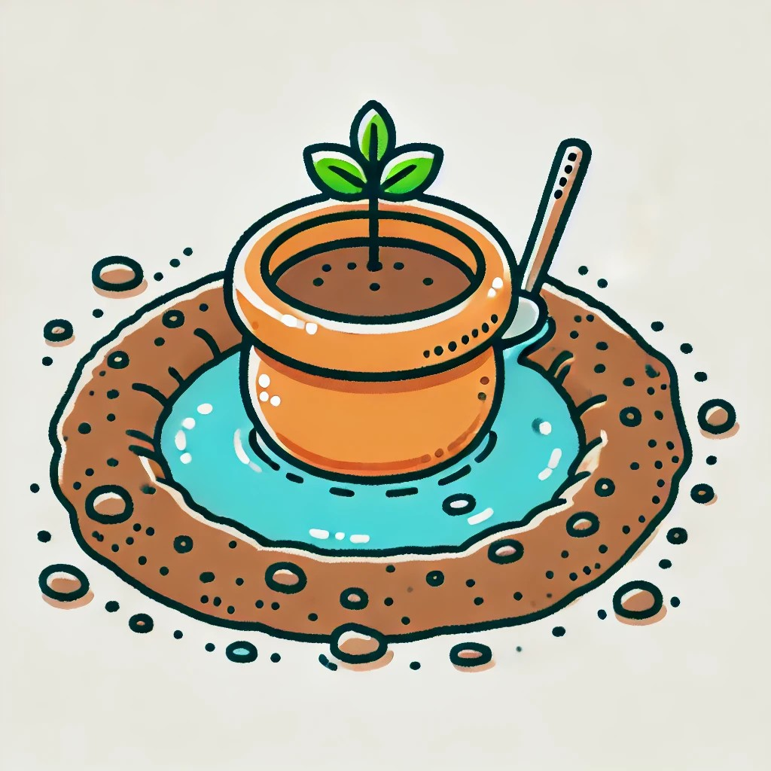
The Pot is in the Pit.

Slide 16
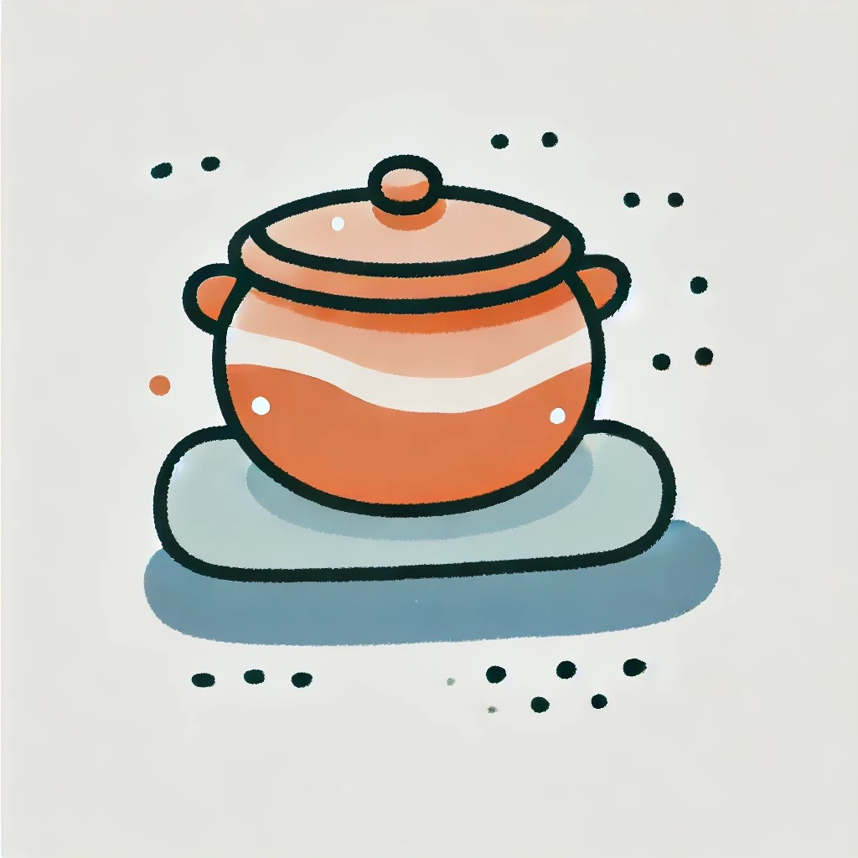
The Pot is on.

Slide 17
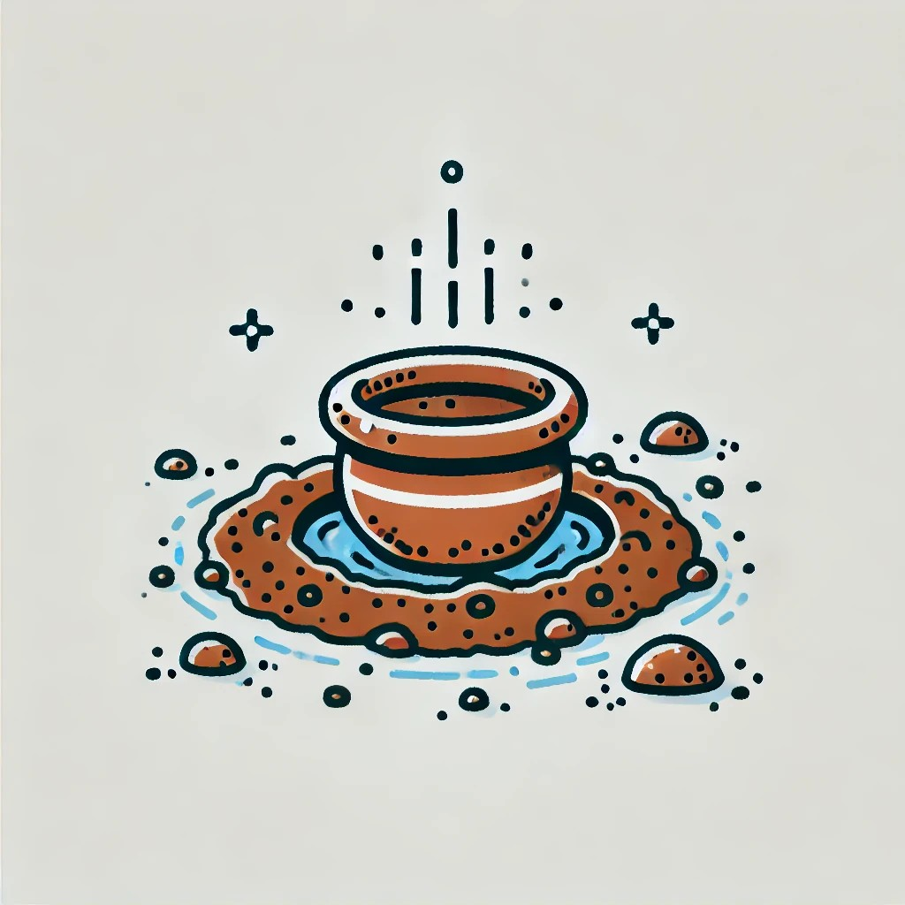
The Pot is in.

Slide 18

The Map is in the Pit.

Slide 19
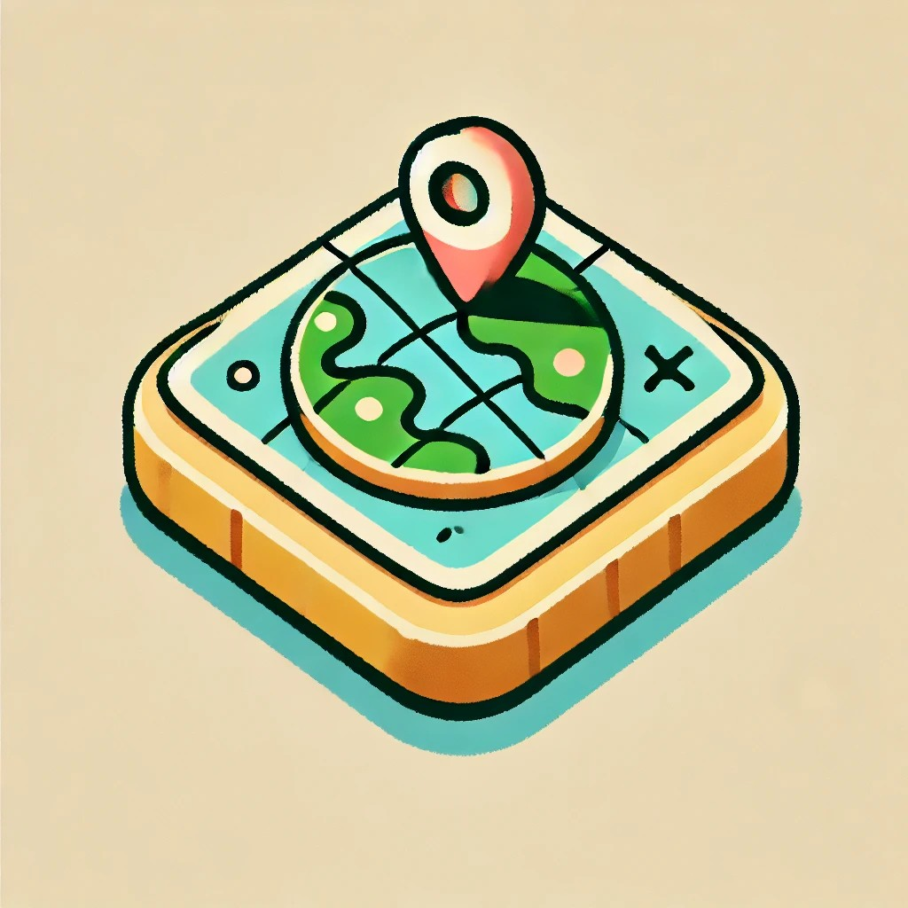
The Map is on.

Slide 20
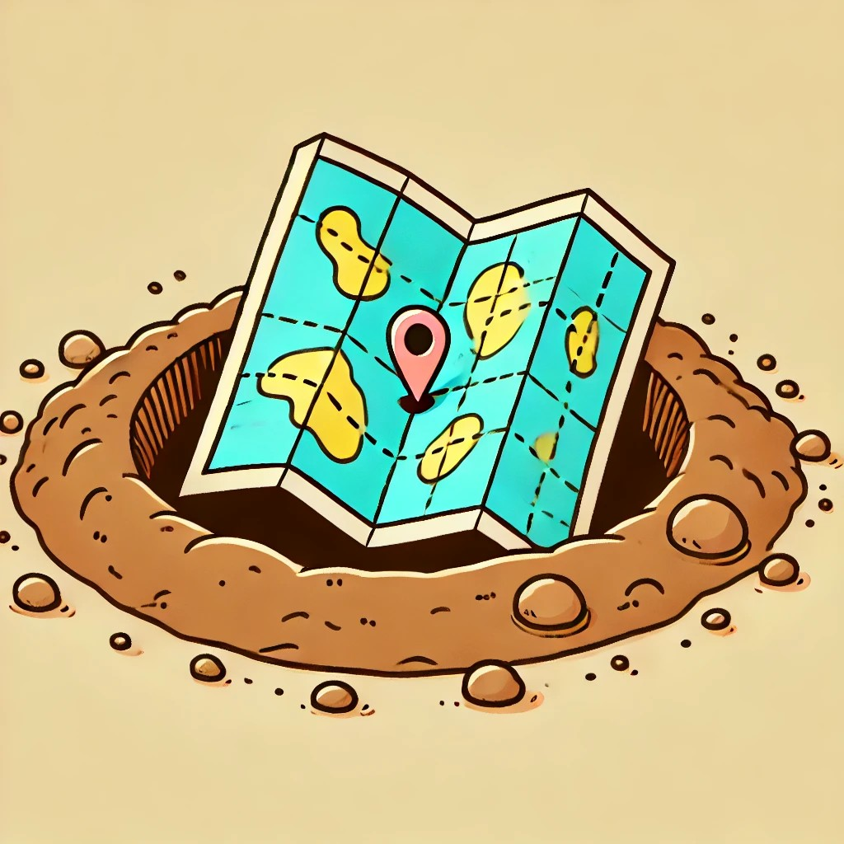
The Map is in.

Slide 21
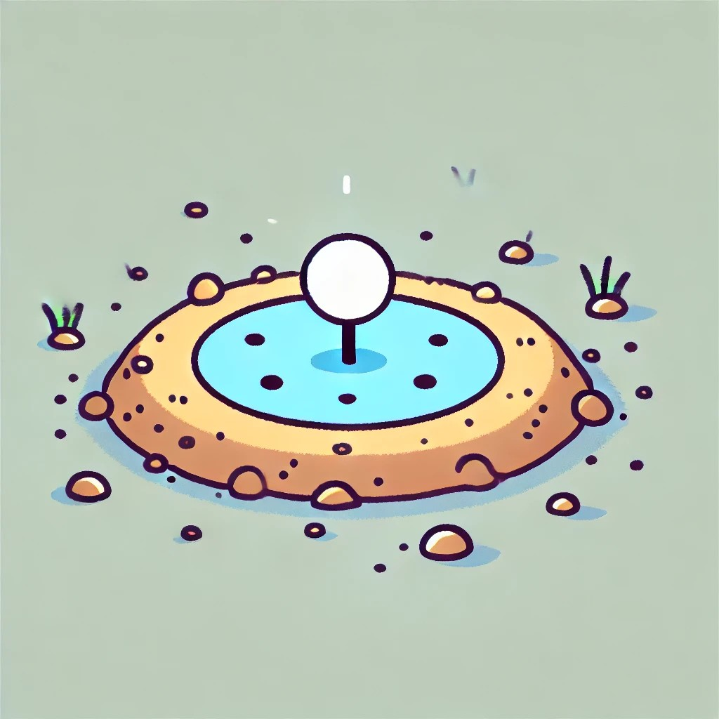
The Dot is in the Pit.

Slide 22
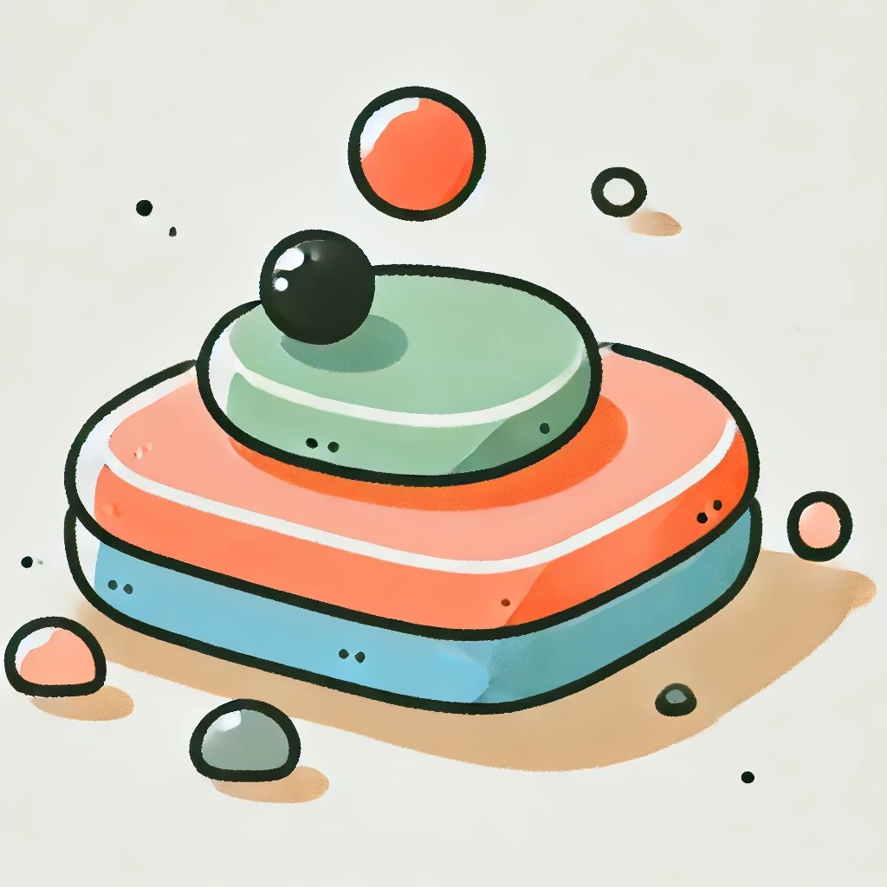
The Dot is on.

Slide 23
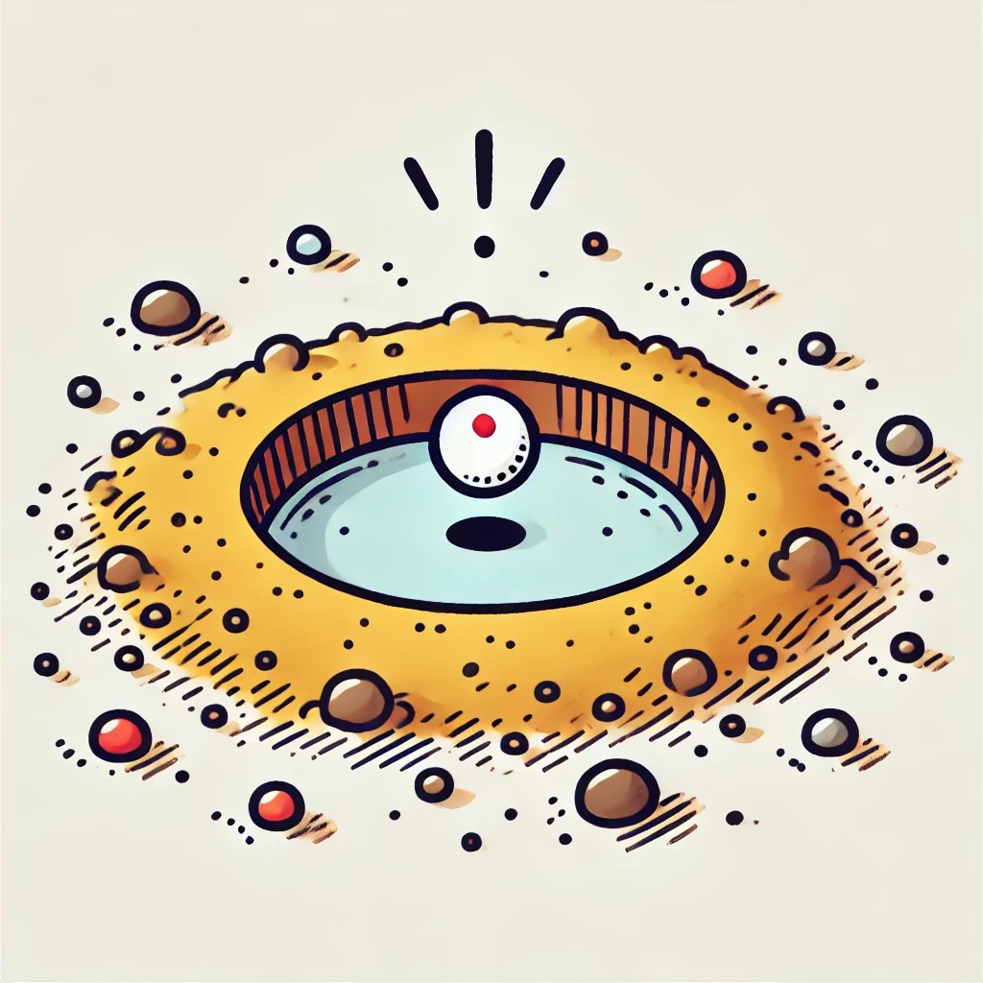
The Dot is in.

Slide 24
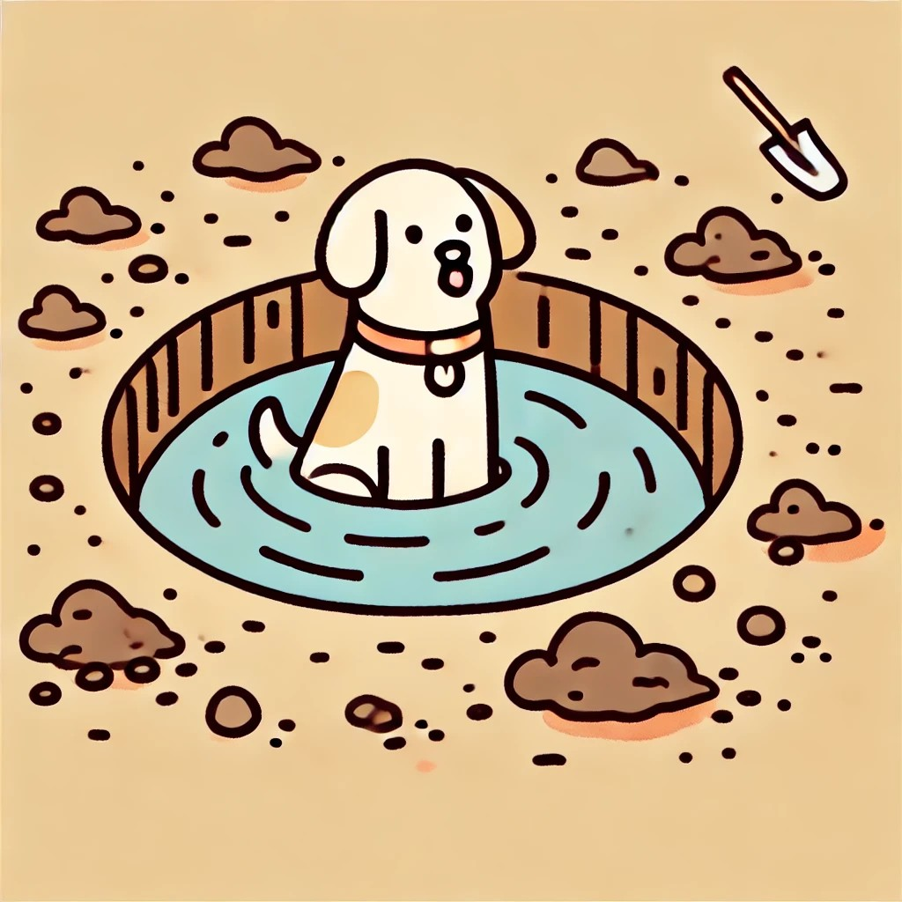
The Dog is in the Pit.

Slide 25
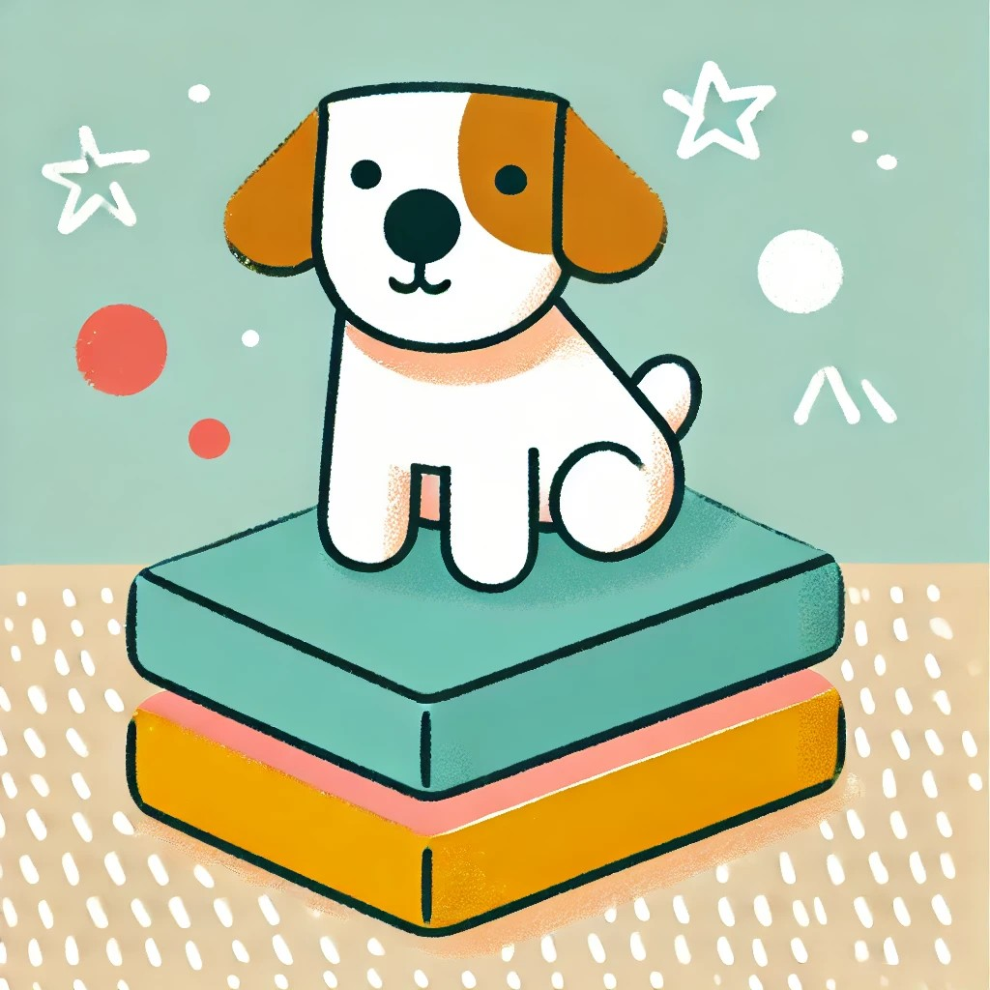
The Dog is on.

Slide 26
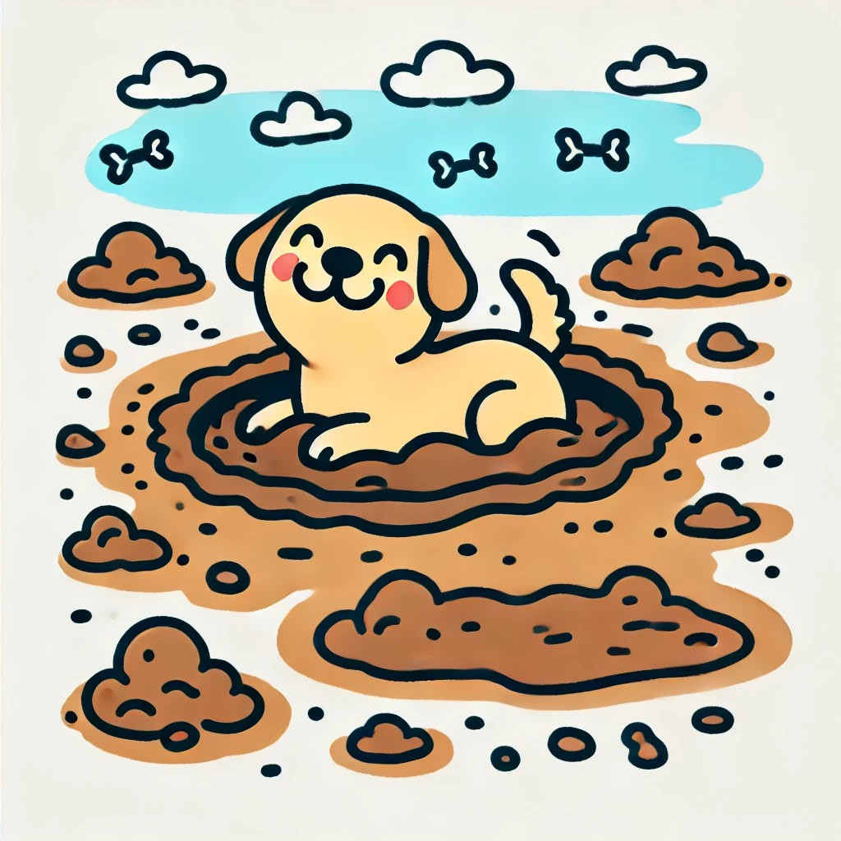
The Dog is in.

Slide 27
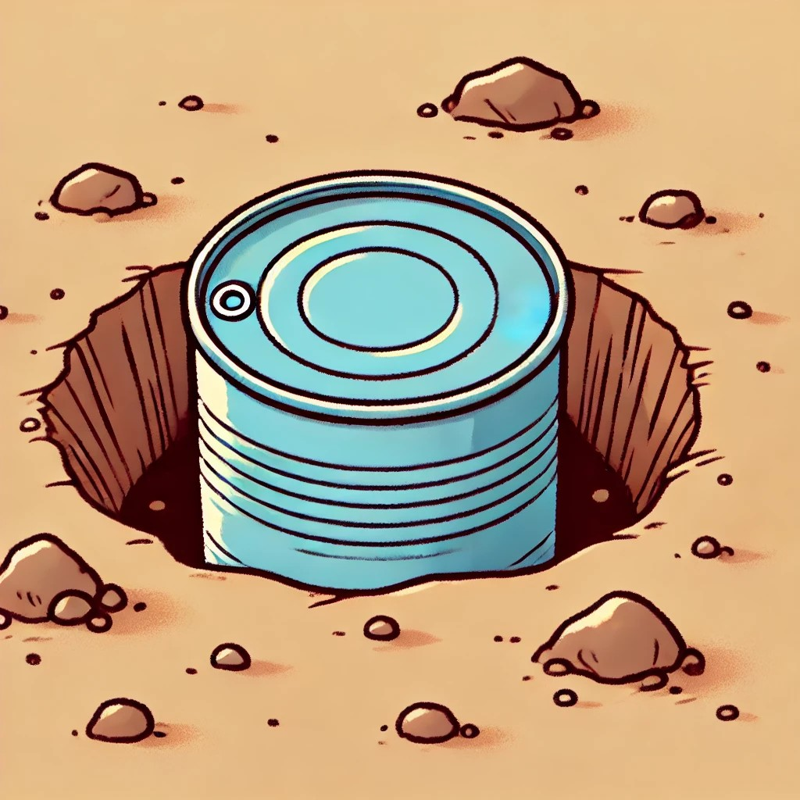
The Tin is in the Pit.

Slide 28

The Tin is on.

Slide 29
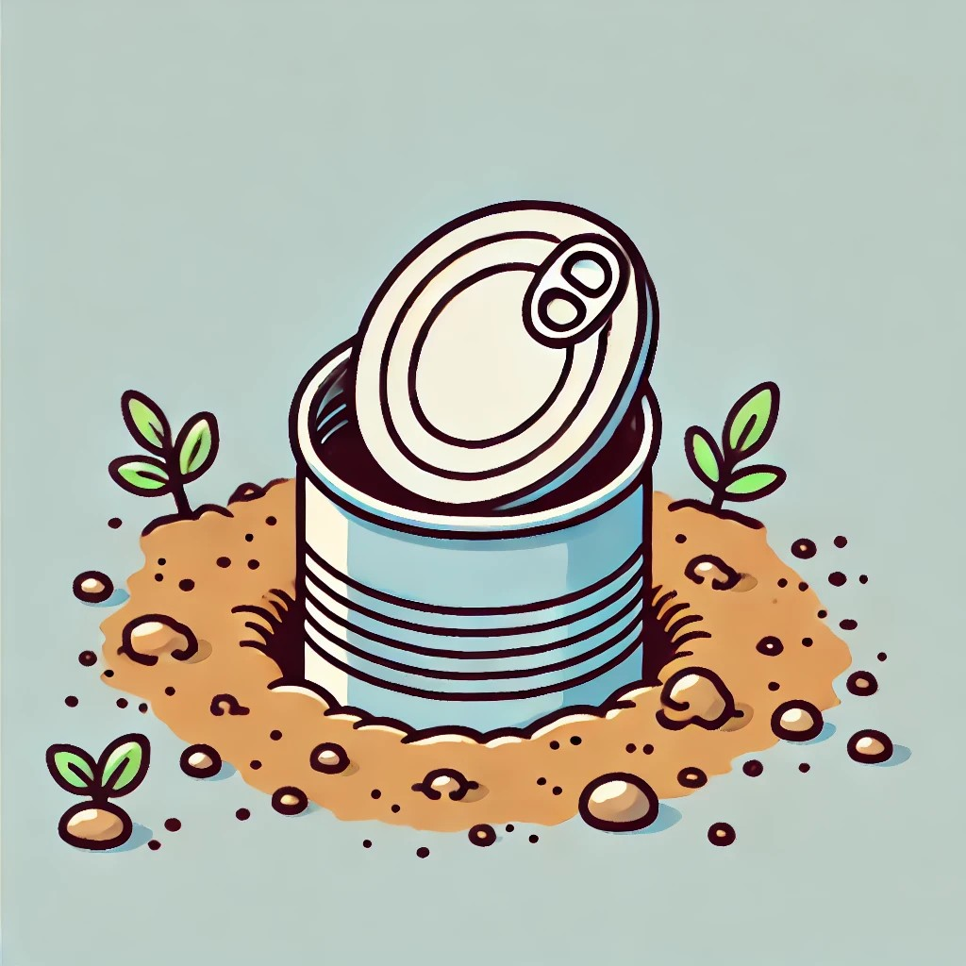
The Tin is in.

Slide 30
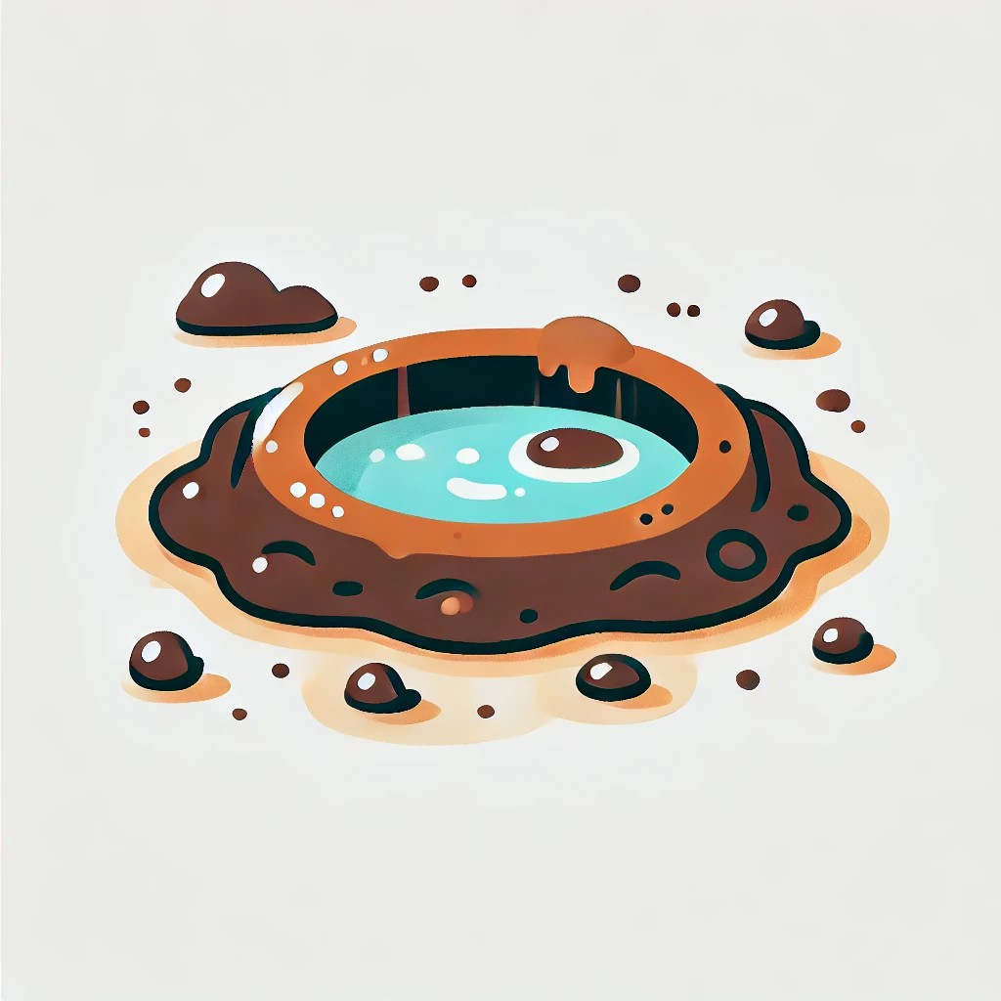
The Mud is in the pit.

Slide 31
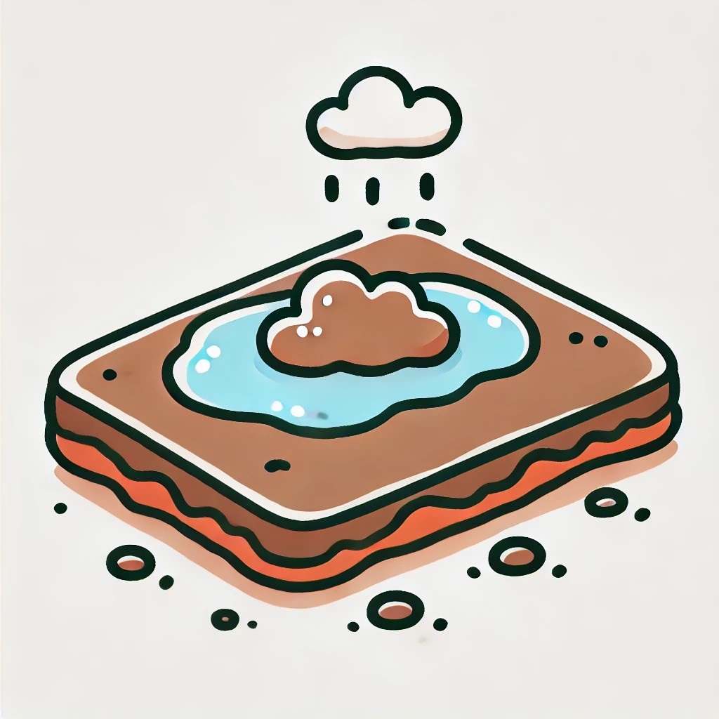
The Mud is on.

Slide 32
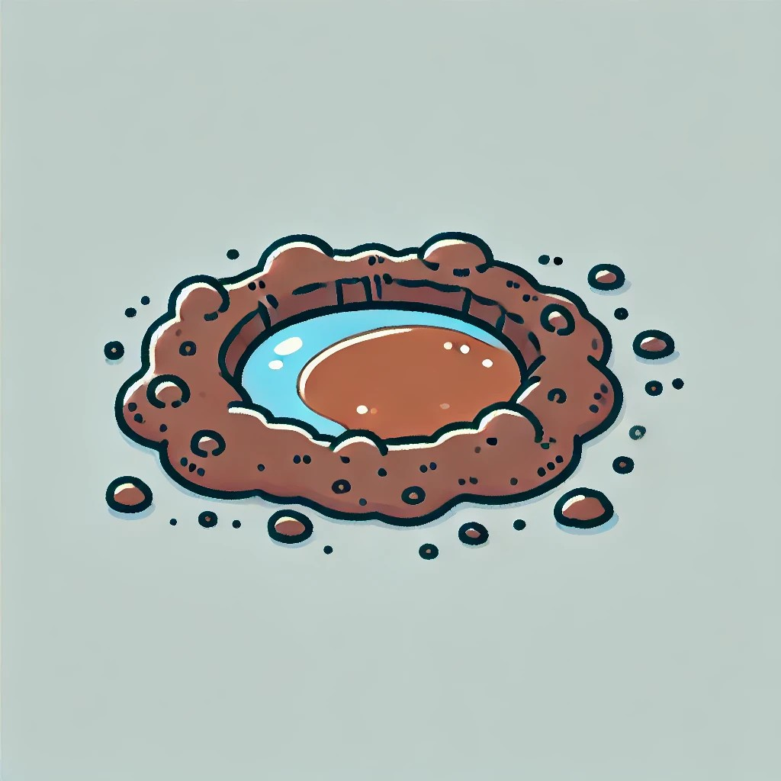
The Mud is in.

Slide 33
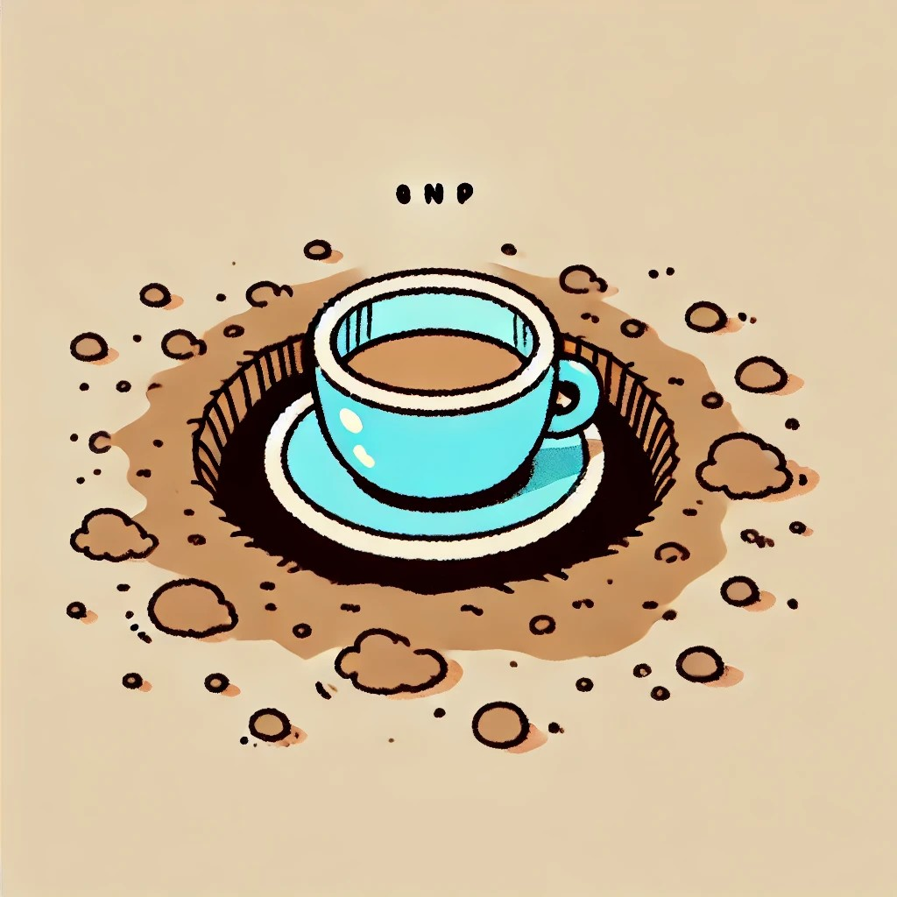
The Cup is in the Pit.

Slide 34

The Cup is on.

Slide 35
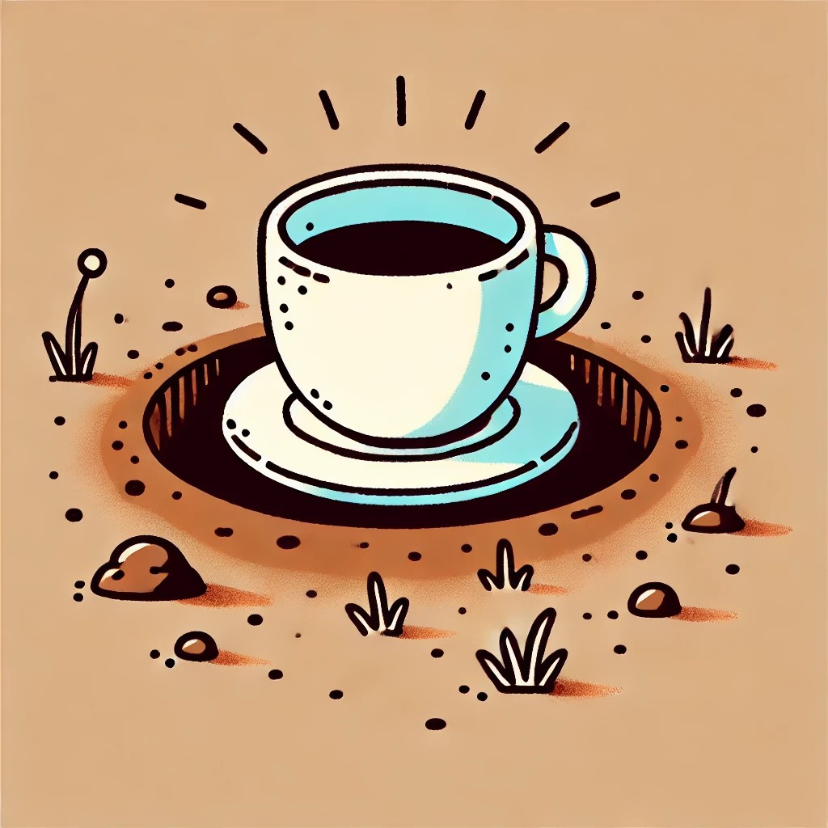
The Cup is in.

Slide 36
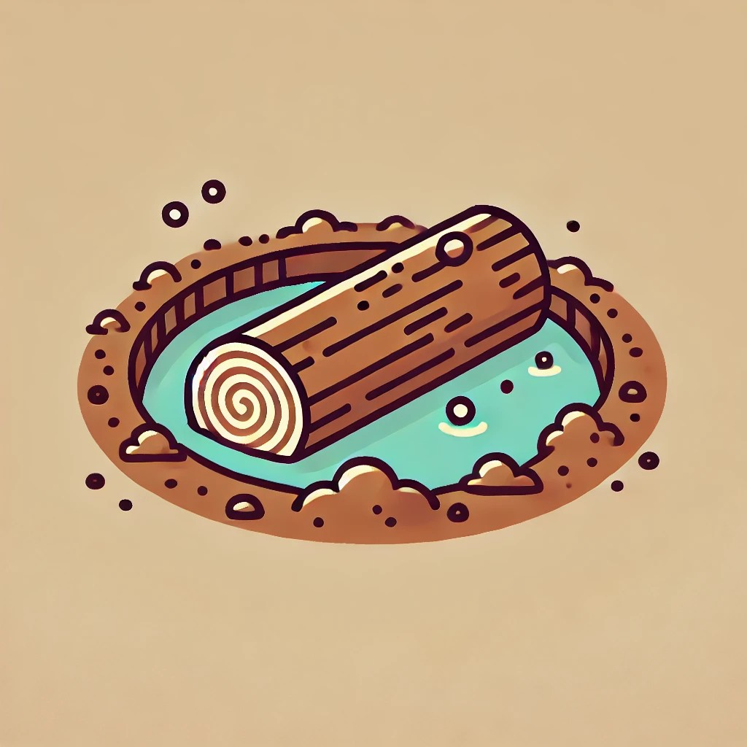
The Log is in the Pit.

Slide 37
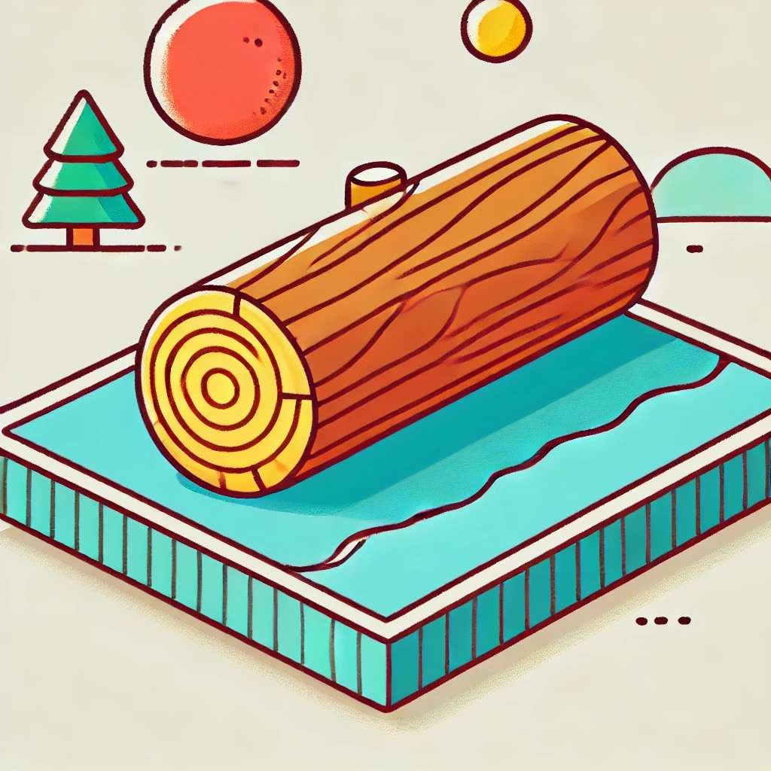
The Log is on.

Slide 38

The Log is in.

Slide 39
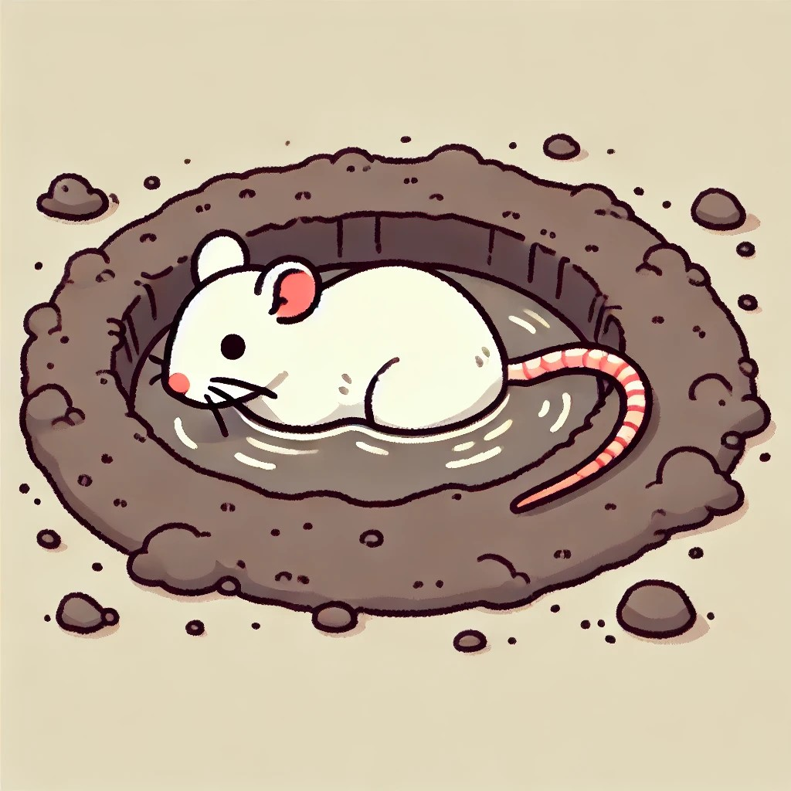
The Rat is in the Pit.

Slide 40
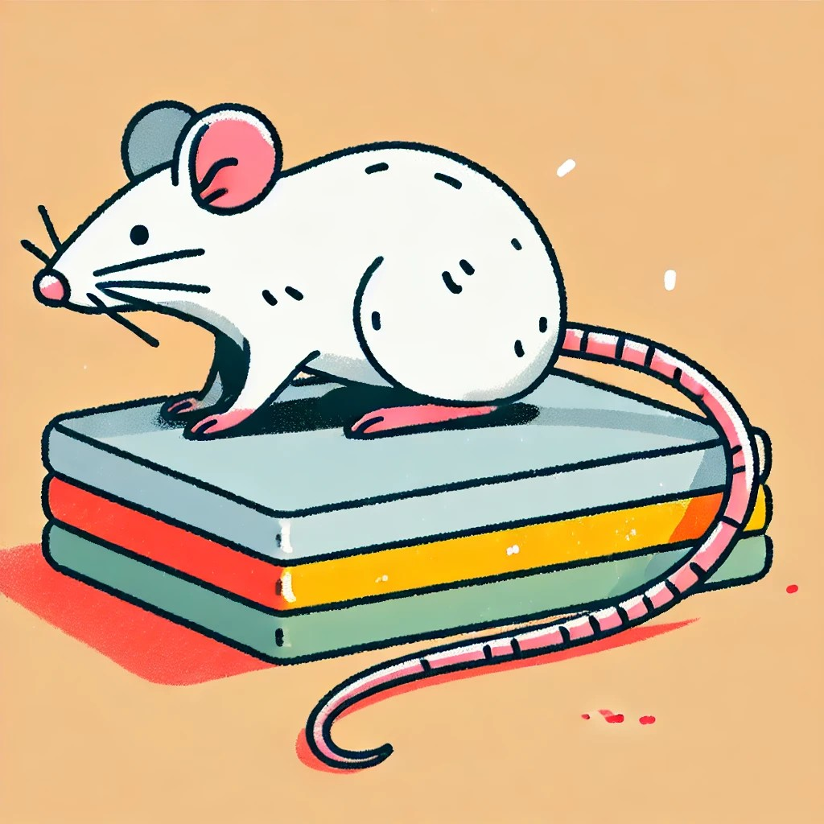
The Rat is on.

Slide 41
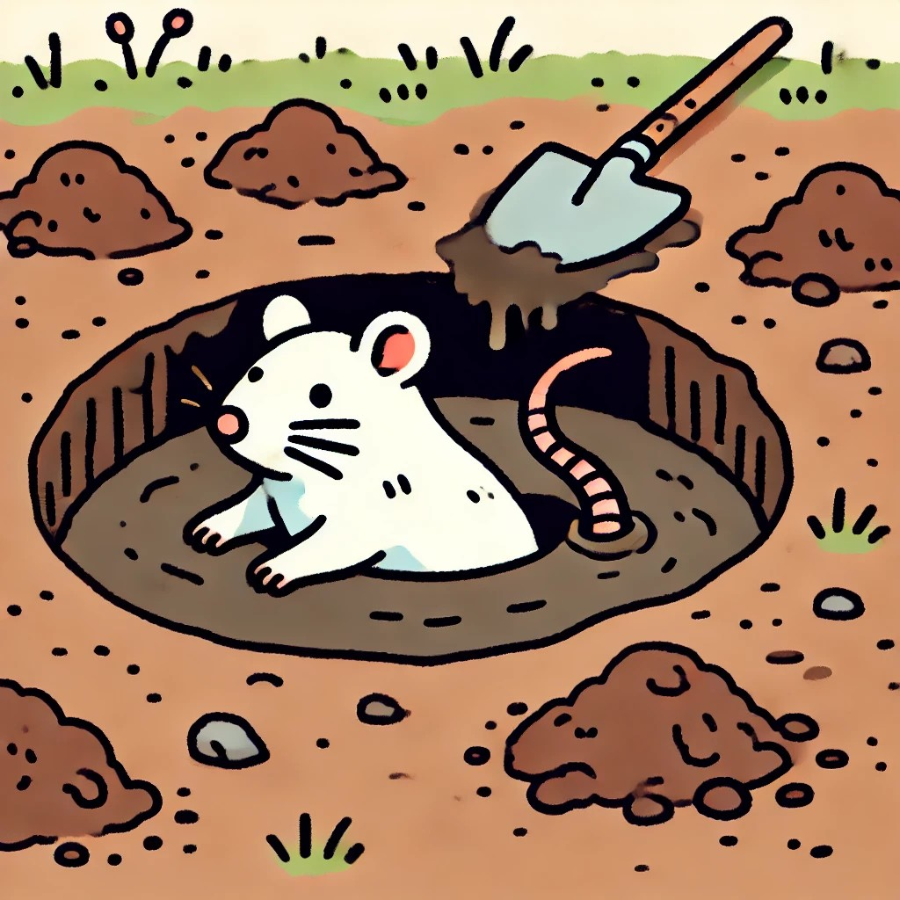
The Rat is in.

Slide 42
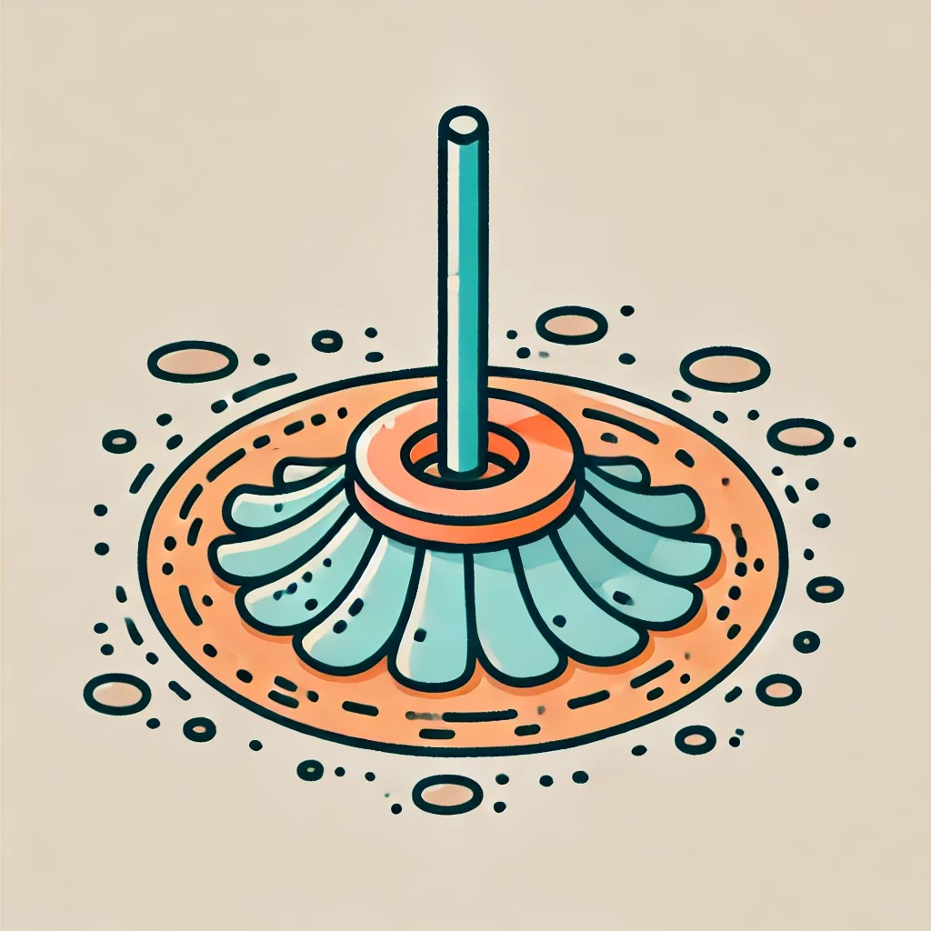
The Mop is in the pit.

Slide 43

The Mop is on.

Slide 44

The Mop is in.

Slide 45
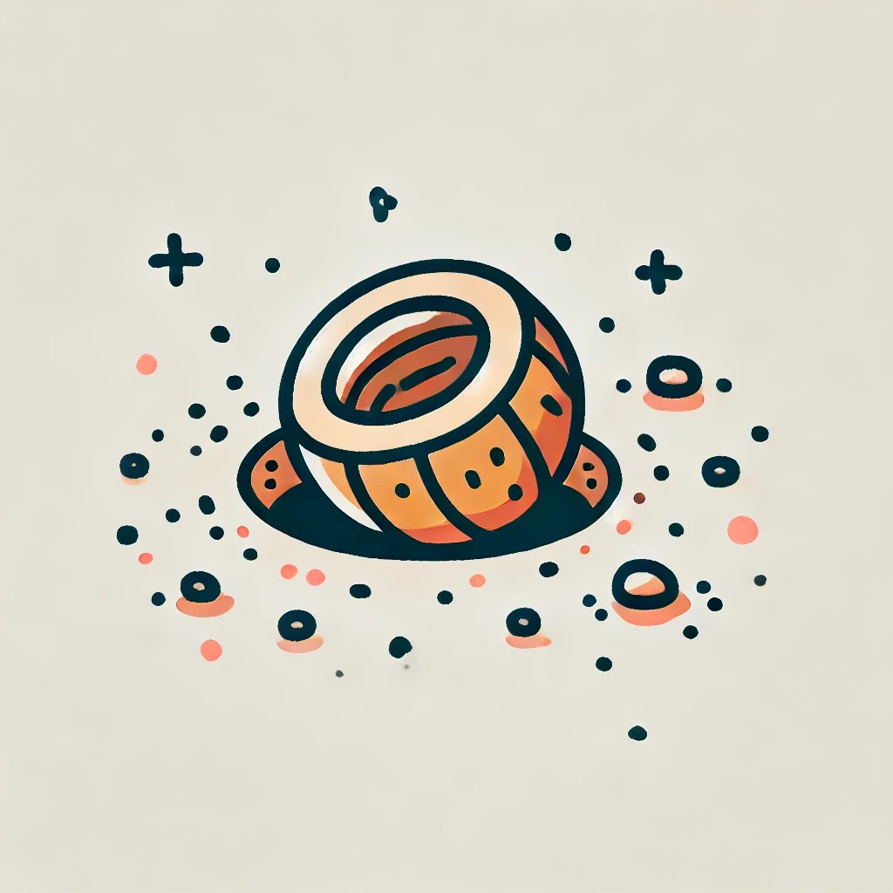
The Nut is in the pit.

Slide 46
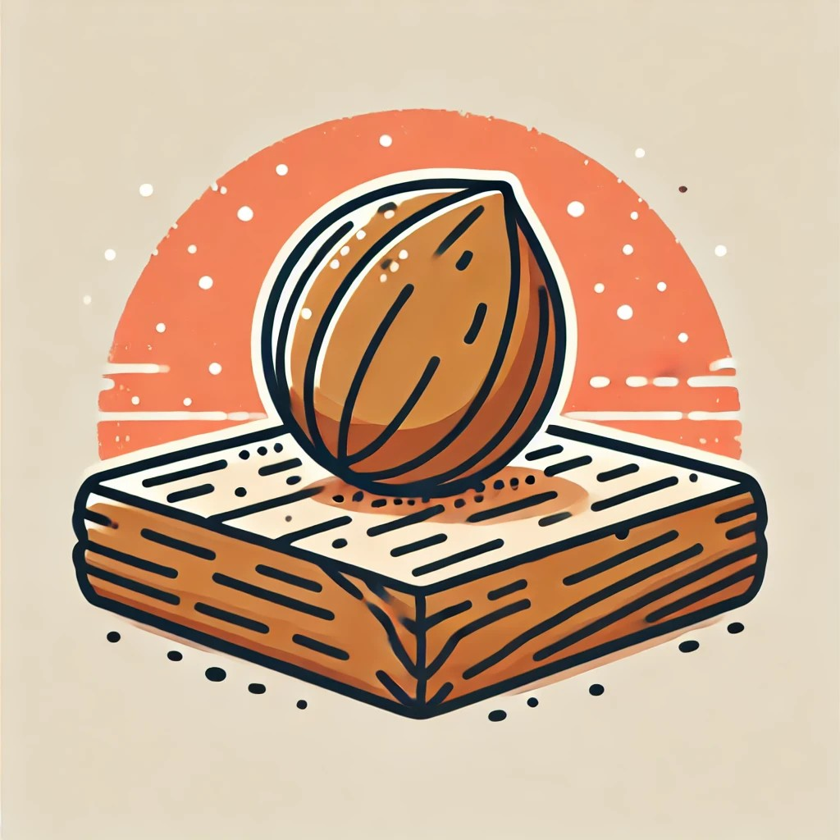
The Nut is on.

Slide 47
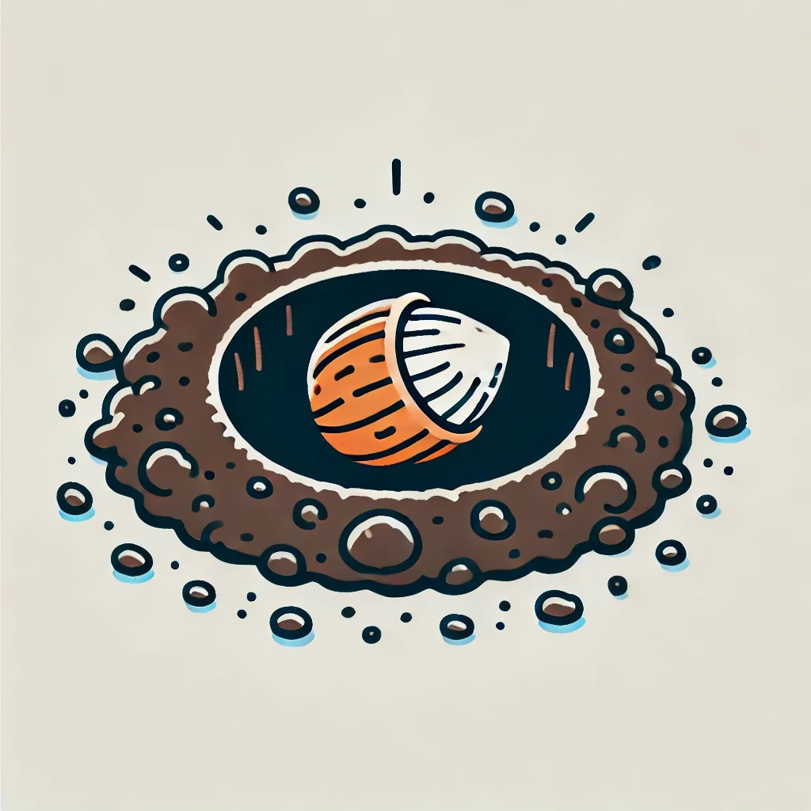
The Nut is in.

Slide 48
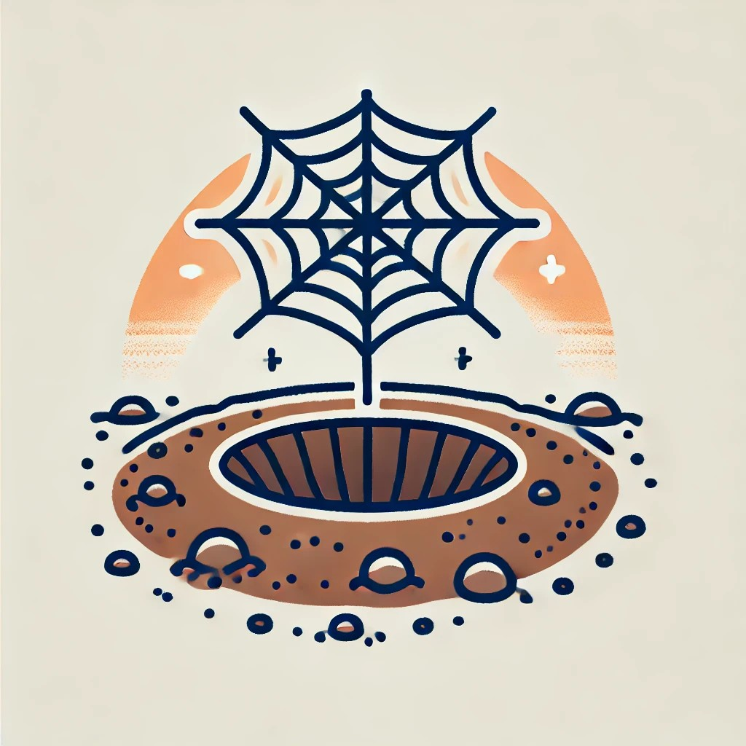
The web is in the pit.

Slide 49
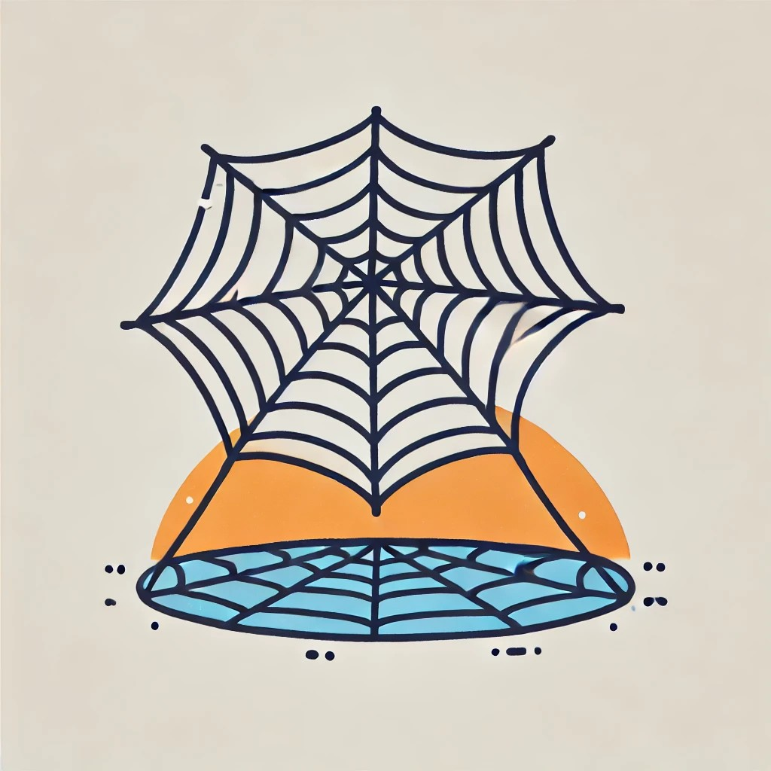
The Web is on.

Slide 50
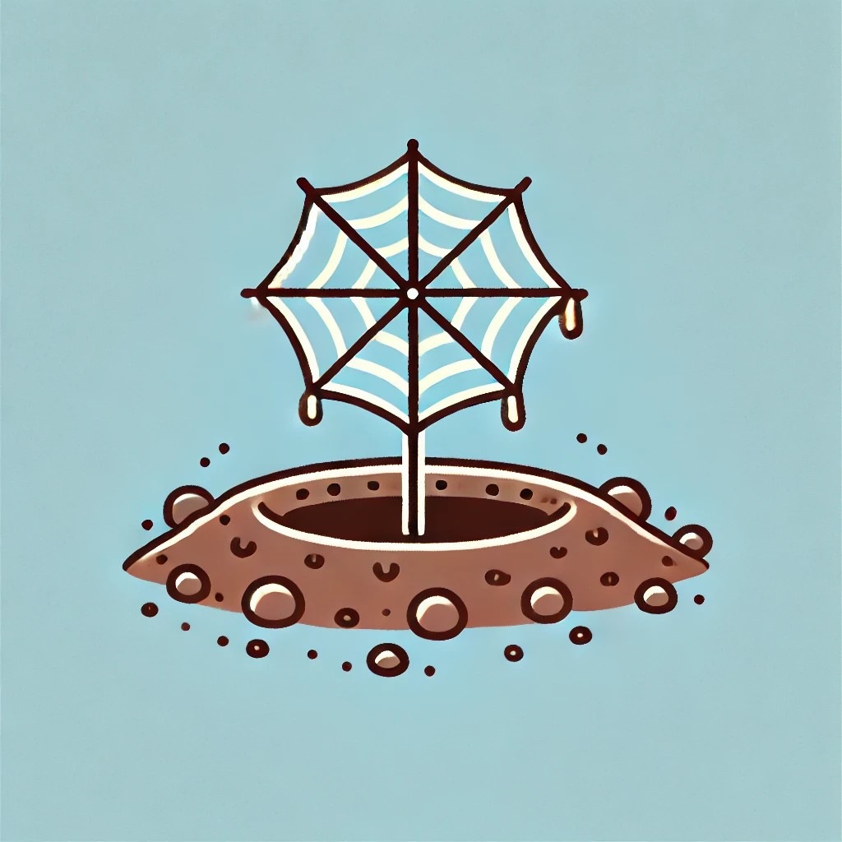
The Web is in.

Slide 51
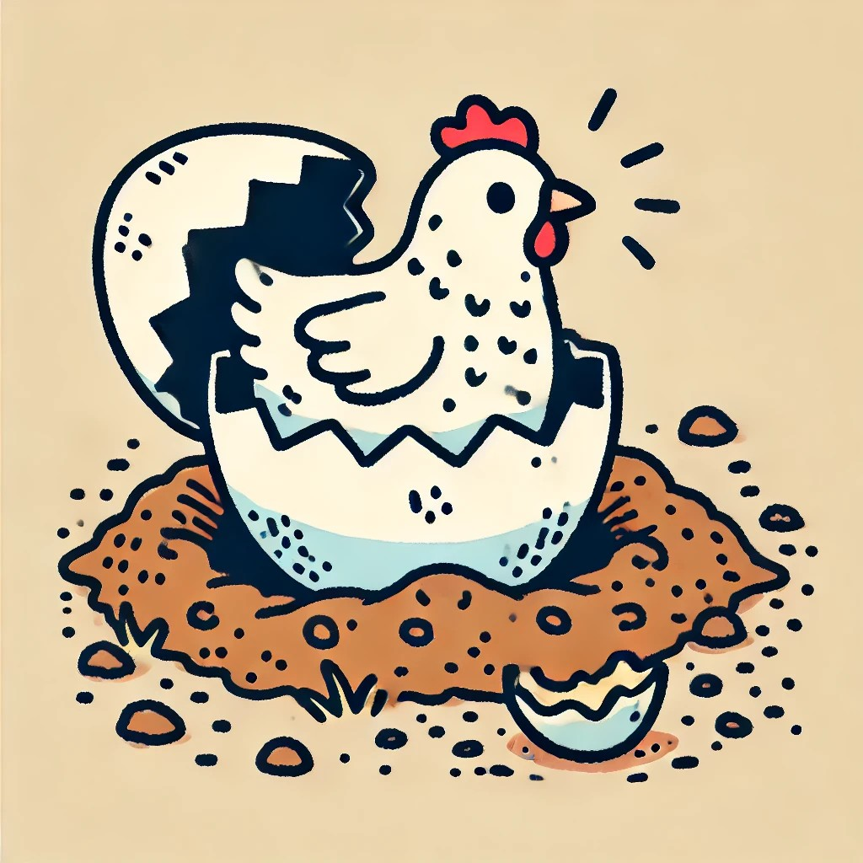
The Hen is in the pit.

Slide 52
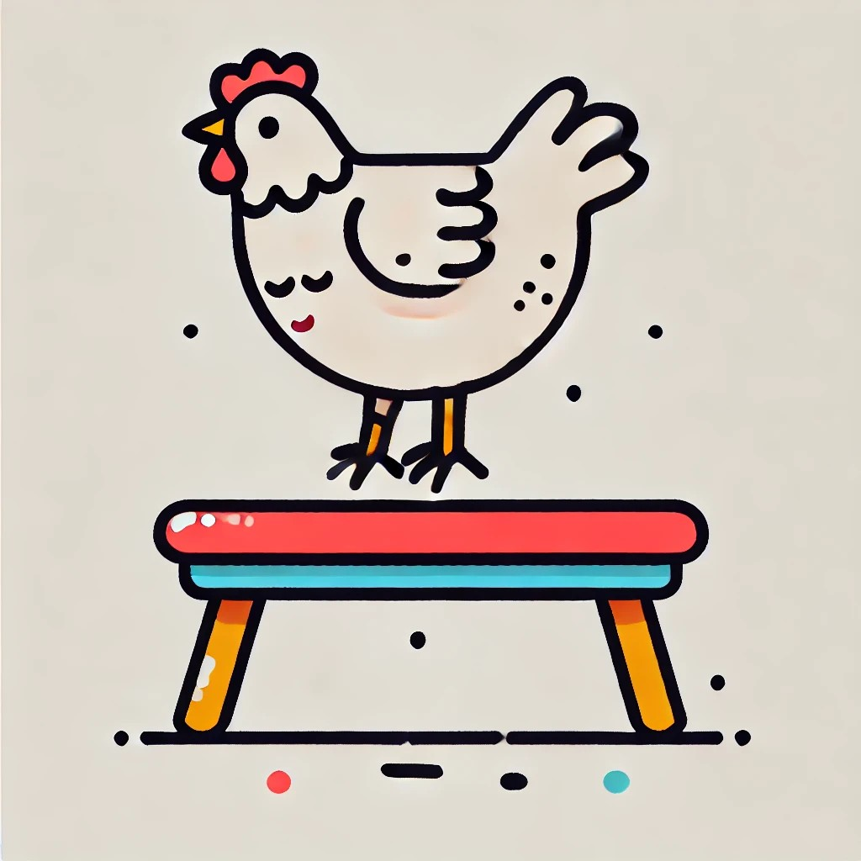
The Hen is on.

Slide 53
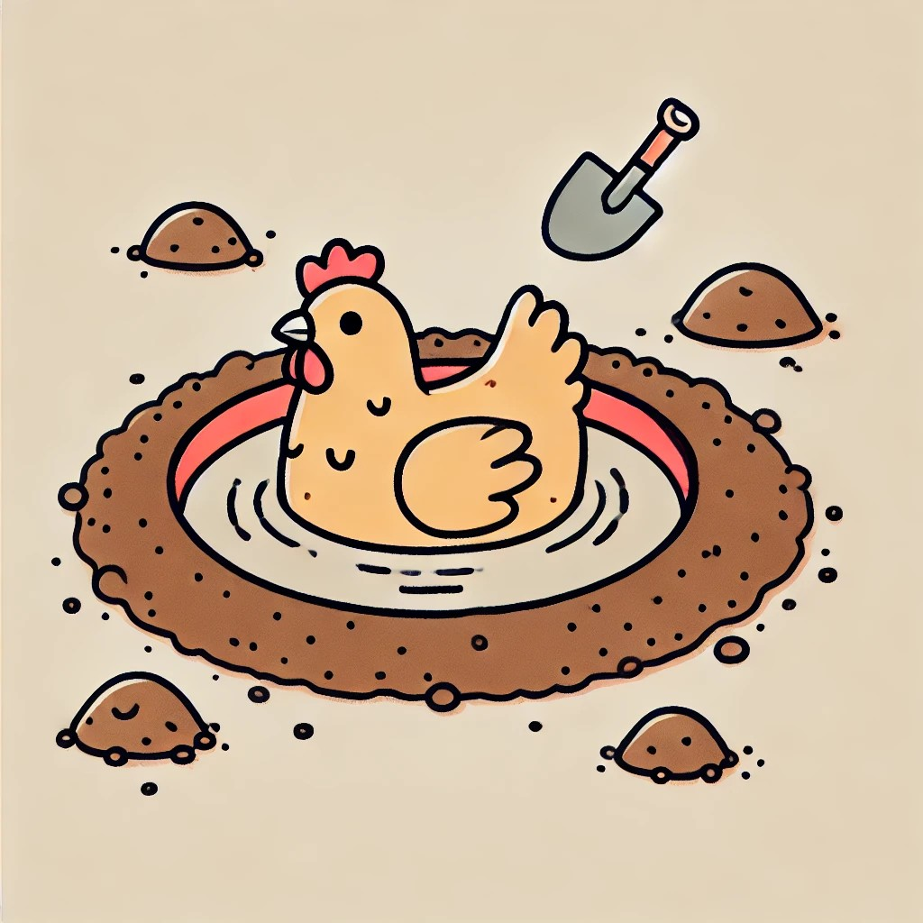
The Hen is in.

Slide 54
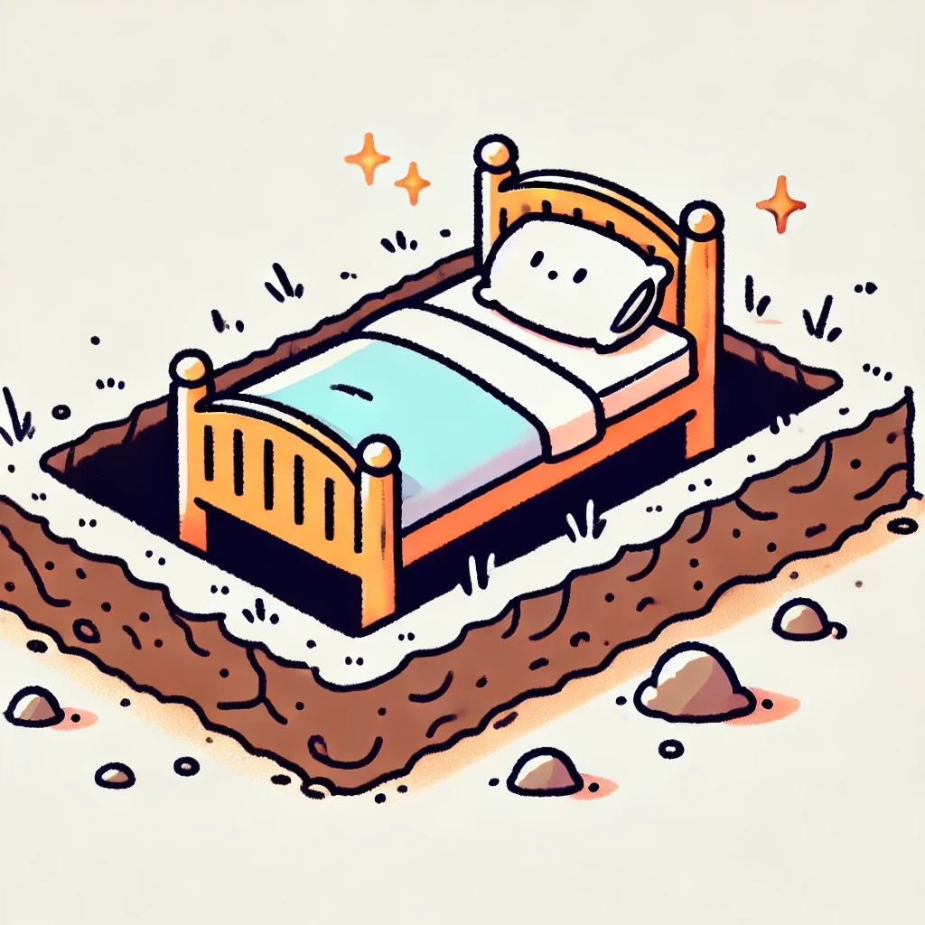
The bed is in the pit.

Slide 55
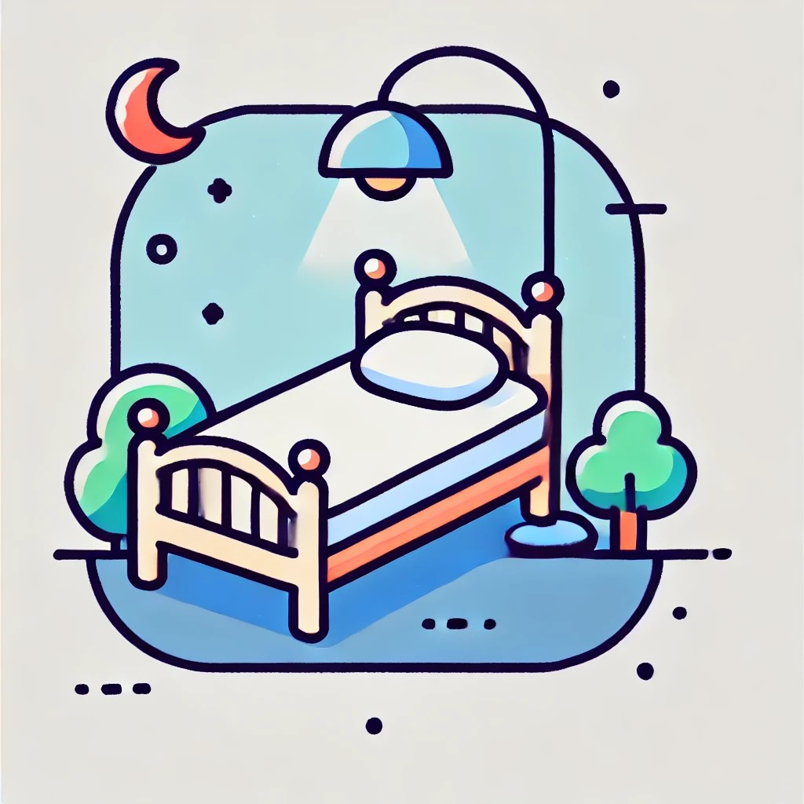
The Bed is on.

Slide 56
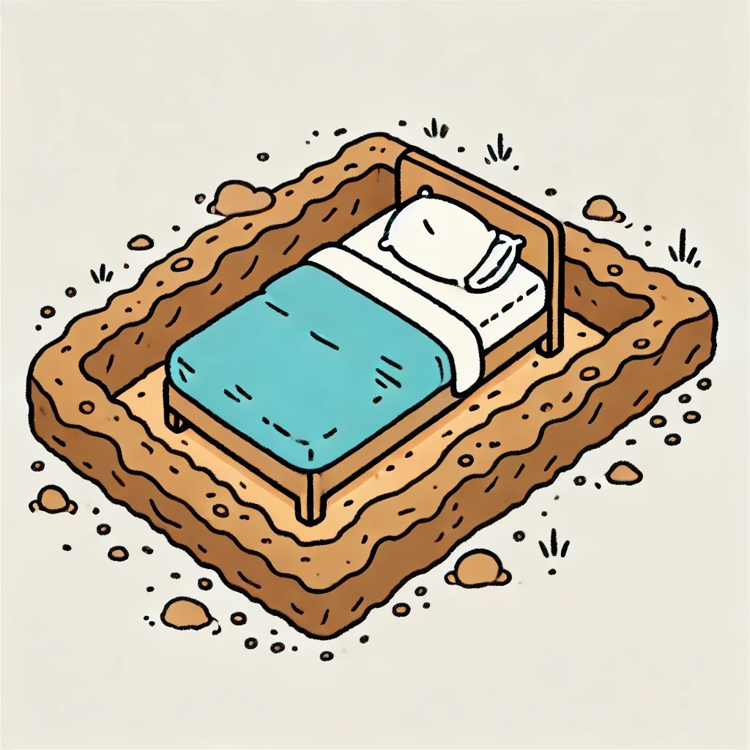
The Bed is in.

Slide 57

The bag is in the pit.

Slide 58
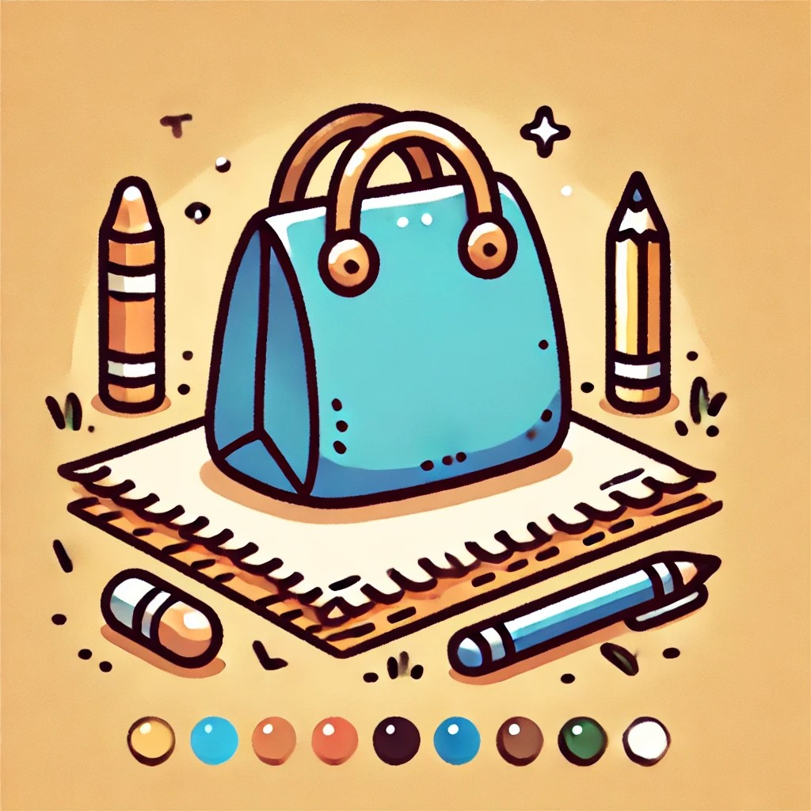
The Bag is on.

Slide 59

The Bag is in.

Slide 60

The Van is in the Pit.

Slide 61

The Van is on.

Slide 62

The Van is in.

Slide 63

The Bus is in the Pit.

Slide 64

The Bus is on.

Slide 65

The Bus is in.

Slide 66

The Pig is in the Pit.

Slide 67

The Pig is on.

Slide 68

The Pig is in.

Slide 69
Reference
OpenAI. (2025). SET 1 design concept [AI-generated image]. DALL·E. Retrieved from [OpenAI Platform] https://chatgpt.com/c/6758dd08-22e0-8005-8145- 9e9ed9217e16
OpenAI. (2025). SET 1: An educational design with vibrant geometric patterns
[AI-generated image]. https://www.meta.ai/

